Slide 1
Angular 4.3.3
Notes:
http://stackoverflow.com/questions/22343224/whats-the-difference-between-tilde-and-caret-in-package-json ("Semantic Versioning Cheatsheet".)
http://plnkr.co/edit/uDGSpV7Z5qzVwxbFPgBQ?p=preview (local)
http://plnkr.co/edit/ue2Yi0usCLVSUw4HAYU0?p=preview

Slide 2
Le Cao
Updated: 25 July 2017

Slide 3

Agenda
High-Level Overview
Architecture
Angular Compiler
Module
Component (basic)
Bootstrap app
Binding (basic)
Component(advanced)
Binding (advanced)
Directives
Form
Routing
DI
Services
Browser/server communication
Manage State
Security
Unit Testing
Webpack
Workshop

Slide 4
Angular High Level Overview (1)
Angular framework is a re-write of popular framework AngularJS 1.x. The newer version has the following advantages over AngularJS
Simpler and Faster
The code is simpler to write and read for Java, C#, and C++ programmers.
Angular app consists of standard ES6 modules. One module per file and one file per module
Use module loader SystemJS or webpack and import statements to load modules so don’t need to worry about the proper of the <script> tag. If a module A needs the functionality from a module B, just import module B inside module A
It performs better than AngularJS - Change detection mechanism are re-written and works faster.

Slide 5
Angular High Level Overview (2)
Lazy load built in
A big goal the Angular team had was to achieve automatic lazy loading. This ensures our applications only load what is necessary for the current page. Lazy loading is also included when routing applications.
Modularity
Modules are a great way to organize the application and extend it with capabilities from external libraries.
Module can be treated as a container for the different parts of your application like component, directive, provider, pipes.., which specify how an application should be bootstrapped.

Slide 6
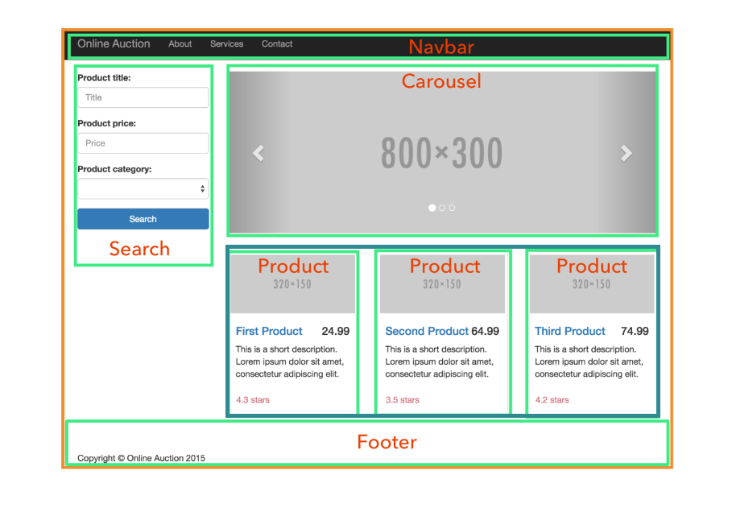
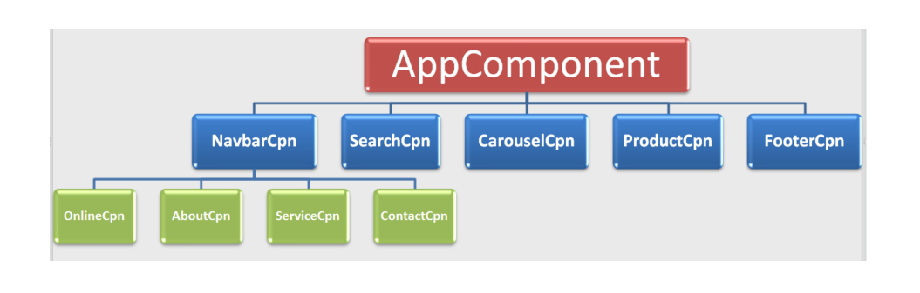
Angular High Level Overview (3)
In Angular an app is a tree of components

Slide 7
Angular Architecture Overview (1)
Angular is designed to be modular
Angular App comprises of several Modules, a module typically exports something of a purpose
A module is a set of similar utilities that perform a similar task.
In Angular , a module is a mechanism to group components, directives, pipes and services that are related, in such a way that can be combined with other modules to create an application.
Many Angular libraries are modules as: FormModule, HttpModule, RouterModule, BrowserModule..
Many third party libraries are available as Angular modules (e.g., Material Design, Ionic, AngularFire2).

Slide 8
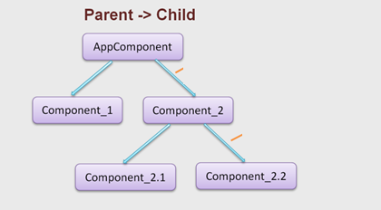
Angular Architecture Overview (2)
An Angular app comprises of several Components as tree, which are connected via routing or selectors.
These components have templates attached to it which may display component properties and attach events to interact with the properties.
A component may use a service, to access a particular feature or perform a very specific task.
Services must be injected into components before they can be used from within the component, this is referred to as DI

Slide 9
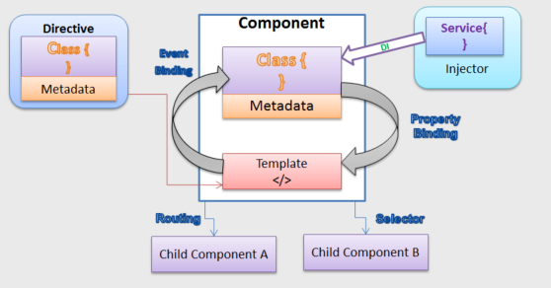
Angular Architecture Overview (2)

Slide 10
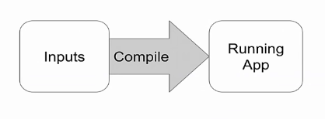
Angular Compiler (1)
Overview
Before the browser can render the application, the components and templates, directives… must be converted to executable JavaScript by the Angular compiler.
There are two ways to compile the Application: Just-in-Time (JiT) and Ahead-of-time (AoT)
There is actually only one Angular compiler. The difference between AOT and JIT is a matter of timing

Slide 11
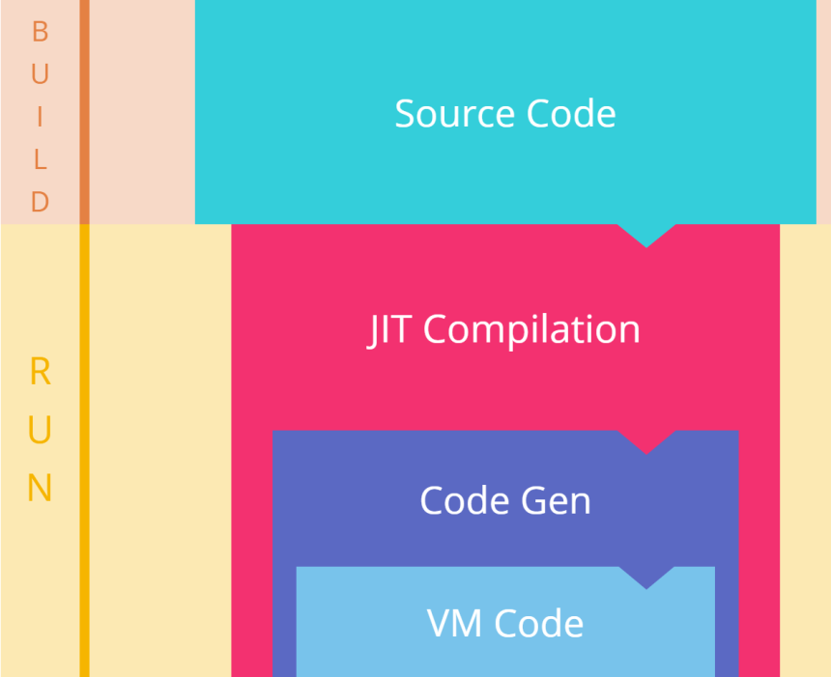
Angular Compiler (2)
Just-in-Time (JiT)
We compile the app in the browser, at runtime, as the application loads.

Slide 12
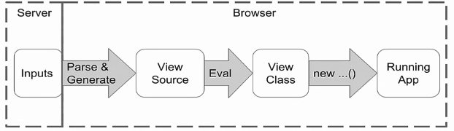
Angular Compiler (3)
How does Just-in-Time (JiT) work?
We have some input (component, template, directives..) that are on server
Then browser loads them up, it parser everything as we had and we generate this view class source.
We need to eval the class source to get an extra class
We can new up this class and get a running application

Slide 13
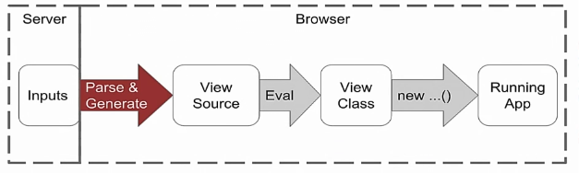
Angular Compiler (4)
Problems with Just-in-Time (JiT)
We need to parse and generate in browser, this takes some times depending on how many components we have. The parser is actually need to be in browser so we need to load the whole compiler into browser and a lot of library code that the application won't actually need. This makes application is bigger. Bigger apps take longer to transmit and are slower to load.

Slide 14
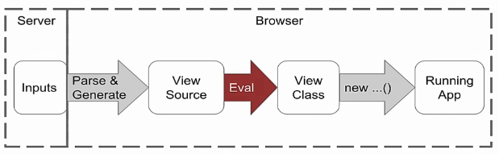
Angular Compiler (5)
Problems with Just-in-Time (JiT)
The problem with Eval- we can make mistakes by using it. Because of these mistakes, somebody can hijack our app
The other problem is that now browser add security content policy as feature, so that the server can tell browser, don’t allow Eval on this page at all. This would mean server can tell browser don’t run Angular on this page

Slide 15
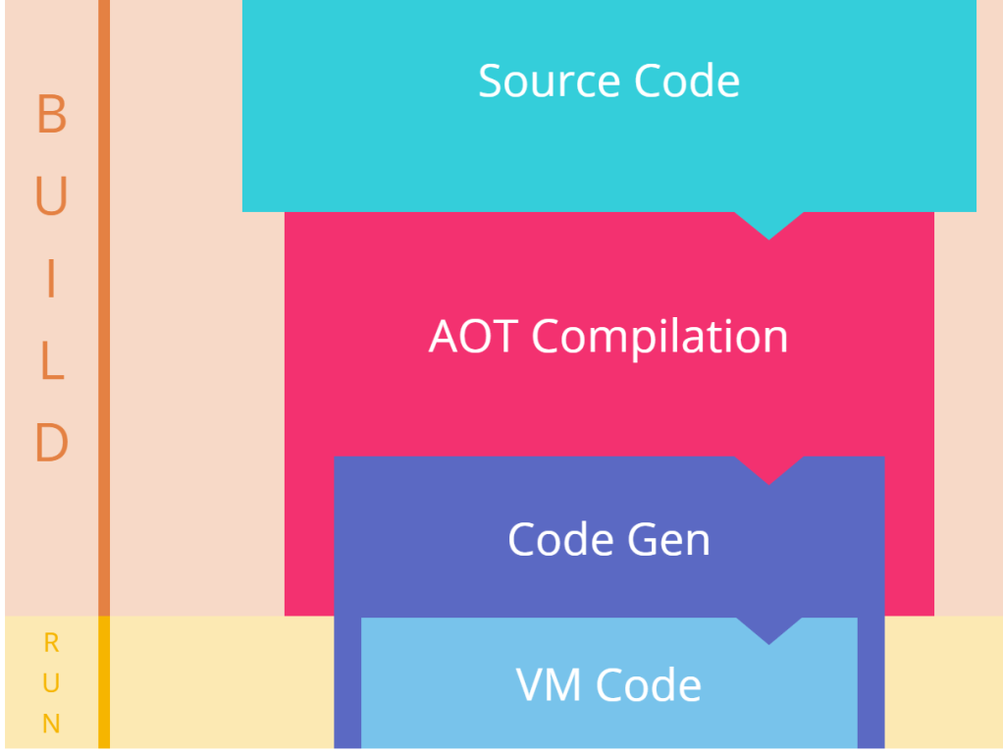
Angular Compiler (6)
Ahead of time (AoT)
The compiler runs once at build time.

Slide 16
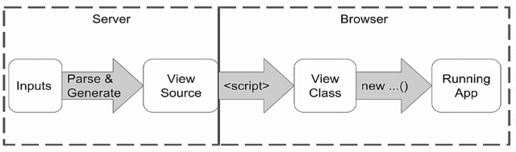
Angular Compiler (7)
How does Ahead of time (AoT) work?
We have some input (component, template, directives..) and they are generated on server
Then browser picks them up and load them as regular script

Slide 17
Angular Compiler (8)
Problems that AoT can resolve.
Faster rendering
Because the parsing and generating happens on server and the complier doesn’t need to be shipped to browser
Detect template errors earlier
The AOT compiler detects and reports template binding errors during the build step before users can see them.
Better security
AOT doesn’t use Eval anymore so there are fewer opportunities for injection attacks

Slide 18
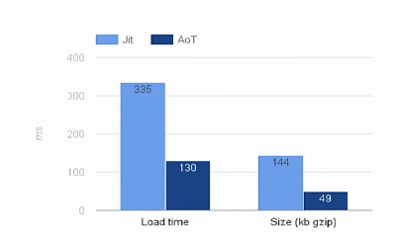
Angular Compiler (9)
JiT vs AoT compilation- page load performance

Slide 19
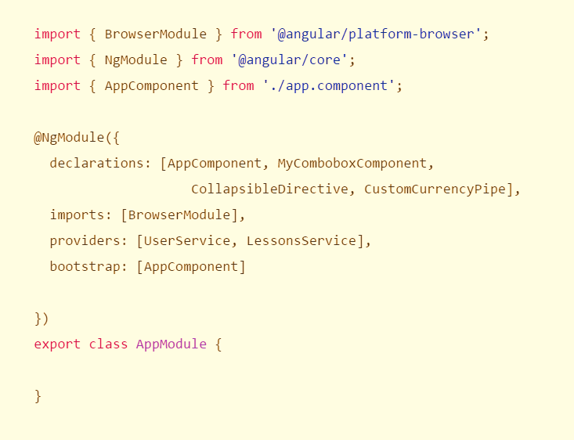
Module (1)
What is NgModule ?
NgModule is an API that allows you to declare a module that directives and pipe, services, etc. collectively. It declared using a decorator called @NgModule.

Slide 20
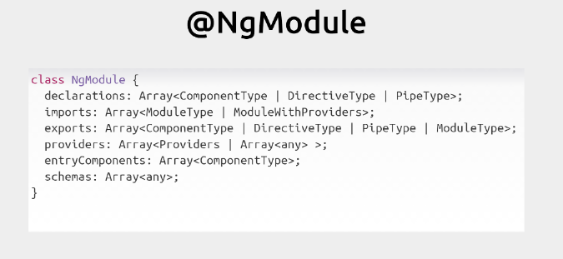
Module (2)
Properties of NgModule?

Slide 21
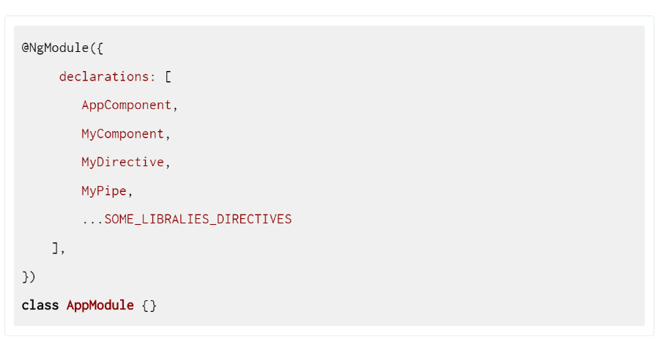
Module (3)
NgModule- declarations property.
Declarations is place to register directives, the pipe and component
These directives, the pipe and component must be declared in exactly one module of the application

Slide 22
Module (4)
NgModule- declarations property.
What classes shouldn’t added to declarations?
a class that is already declared in another module, whether an app module, @angular module, or 3rd party module
an array of directives imported from another module. For example, do not declare FORMS_DIRECTIVES from @angular/forms.
module classes
service classes
non-Angular classes and objects such as strings, numbers, functions, entity models, configurations, business logic, and helper classes.

Slide 23
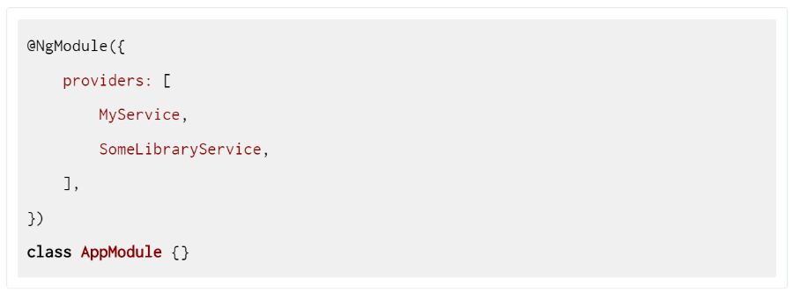
Module (5)
NgModule- providers property
This property is the place to declare services of the module.

Slide 24
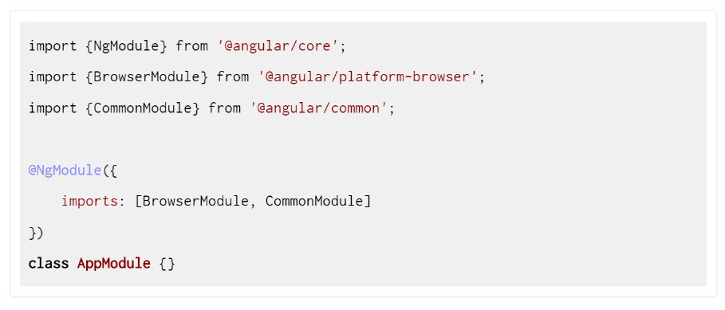
Module (6)
NgModule- imports property
This property is the place to declare modules of the module.

Slide 25
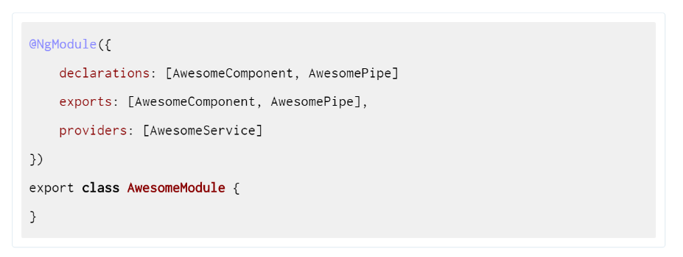
Module (7)
NgModule- exports property
This property is place to export any declarable class — components, directives, and pipes

Slide 26
Module (8)
NgModule- bootstrap property
Bootstrap property, which allows you to specify which components to become entry point for the application.

Slide 27
Component (1)
What is Component?
In Angular , we don’t have controllers nor scope anymore. So.. What do we use to create pages? We use a Component
In Angular, we have 3 types of directives.
The ones change the DOM layout by adding and removing DOM elements called as Structural directive as ngIf, ngFor…
The ones change the appearance or behavior of an element called Attribute directive as ngStyle…
The ones that always associated with direct template call Component
So a component is a directive that has a template and that is what we use to represent a page in Angular .
A component is simply a class.

Slide 28
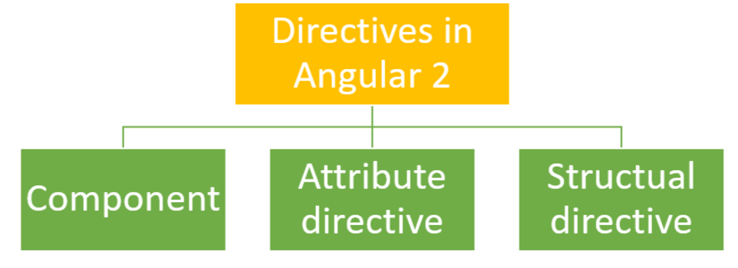
Component (2)
What is Component?
What makes this class a component? In Angular we have annotations. Annotations are a way to add metadata to a class. So there is an annotation called Component which we can use to say that a particular class is a Component.

Slide 29
Component (3)
How to create a Component?
Step 1: As Component is a class so we will create class called MyComponent
class MyComponent {
constructor() { }
ToDo() { }, // Functions
Name: string // variables
}

Slide 30
Component (4)
How to create a Component?
Step 2: Notify Angular knows that class MyComponent is a Component by add @Component to class MyComponent.
@Component({
selector: 'my-app', // html tag
styles: [` .main-text { color: orange } `] Or styleUrls // Define Style
template: ` <h1 class="main-text">Hello Co Ba</h1> ` Or templateUrl
// Define layout component
})
class MyComponent {
constructor() { }
ToDo() { }, // Functions
Name: string // variables
}

Slide 31
Component (5)
How to create a Component?
Step 3: Tell Angular knows that we want to use @Component from module @angular/core by using import statement
import { Component } from ‘@angular/core‘
@Component({
selector: 'my-app', // html tag
styles: [` .main-text { color: orange } `] Or styleUrls // Define Style
template: ` <h1 class="main-text">Hello Co Ba</h1> ` Or templateUrl })
class MyComponent {
constructor() { }
ToDo() { }, // Functions
Name: string // variables
}

Slide 32
Component (6)
How to create a Component?
The stuff hasn’t done yet. We need to export MyComponent to make it can be use anywhere.
import { Component } from ‘@angular/core‘
@Component({
selector: 'my-app', // html tag
styles: [` .main-text { color: orange } `] Or styleUrls // Define Style
template: ` <h1 class="main-text">Hello Co Ba</h1> ` Or templateUrl
// Define layout component
})
Export class MyComponent {
constructor() { }
ToDo() { }, // Functions
Name: string // variables
}

Slide 33
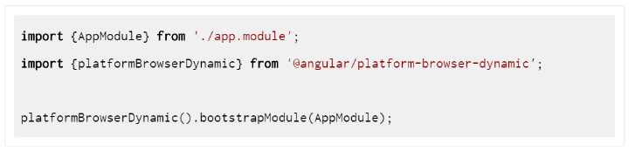
Bootstrap app (1)
How to bootstrap NgModule (bootstrap app) ?
We launch the application by bootstrapping the root Module ex: AppModule
Dynamic bootstrapping with the Just-In-Time (JIT) compiler
The Angular compiler compiles the application in the browser and then launches the app.
https://plnkr.co/edit/jgtplsGJtE2sIbpFjAz7?p=preview
Notes:
https://plnkr.co/edit/jgtplsGJtE2sIbpFjAz7?p=preview

Slide 34
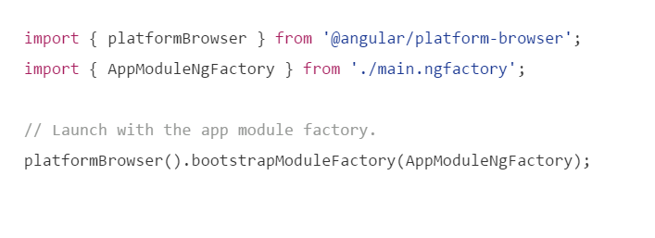
Bootstrap app (2)
How to bootstrap NgModule ?
Static bootstrapping with the Ahead-Of-Time (AOT) compiler
In the static option, the Angular compiler runs ahead of time as part of the build process, producing a collection of class factories in their own files. Among them is the moduleNamengFactory: AppModuleNgFactory.

Slide 35
Binding (1)
The new binding syntax
There are 2 types binding data in Angular : one way binding (unidirectional), two-way binding
These 2 types of data binding were already available in Angular 1, but now in Angular the syntax has changed a bit.
The new syntax is also easier to learn for beginners. We simply need to learn to write square brackets around HTML properties you already know. There is no more need to learn all of these specific cases such as ng-src., ng-show, ng-hide, ng-click, …

Slide 36
Binding (2)
One way binding
Property bindings - [ ] (from Data -> View)
In Angular 1.x, ng-bind is used for one way data binding, but with Angular 2 it is replaced with [property], where property is valid HTML DOM element property.
Angular 1.x, one way data binding
Angular 2, one way data binding is achieved via wrapping the properties with square brackets. It called Property bindings [ ]
<input ng-bind=“customer.name"></input>
Property : [target] : <input type=”text” [value]=”myName”>
Attribute : [attr.] : <button [attr.aria-label]=“abc">help</button Class : [class.] : <div [class.special]="isSpecial">Special</div Style : [style.] : <button [style.color] = "isSpecial ? 'red' : 'green'">

Slide 37
Binding (3)
One way binding
Property bindings – Interpolation {{ }}
Interpolation is a special syntax that Angular converts into a property binding
<div> {{name}}</div>
or
<div [innerHTML]=" name "></div>

Slide 38
Binding (4)
One way binding
Event bindings: ( ) (From View -> Data)
In Angular 1.x , we had to rely on directives as ng-click, ng-change…to handle different events, angular 2 has dropped all these directive and create a new, a powerful syntax that allows us to bind to any valid DOM event as click, dbclick…
By passing in the name of the event into parenthesis, which signifies an event binding in Angular 2
Use the on-preface to bind to an event in a way that you would be more used to in Angular 1.x
< div (click)="myAction()"></ div>
< div on-click ="myAction()"></ div>

Slide 39
Binding (5)
Two way binding- (From View ⬄Data)
In Angular 1.x, ng-model is used for two way data binding,
By default Angular 2 doesn’t use a two-way data binding. It uses a unidirectional binding but if offers us a simple syntax for a two-way data binding
In short two-way data binding in Angular is a combination of event and property binding on the same element.
<input type="text" [value]="lastStockSymbol" (input)="lastStockSymbol=$event.target.value" >

Slide 40
Binding (6)
Two way binding
This can also be achieved by using [ngModel] input property and (ngModelChange) output property, these two directives simply allow to set the desired property and listen to the required user events on components.
Or by adding the ngModel directive as an HTML attribute surrounded with both parentheses and square brackets
https://plnkr.co/edit/diXWOHiRCQxgRQUKphob?p=preview
<input type="text" [ngModel]="lastStockSymbol" (ngModelChange)="lastStockSymbol=$event" >
<input [(ngModel)] = "myComponentProperty">
Notes:
https://plnkr.co/edit/diXWOHiRCQxgRQUKphob?p=preview

Slide 41
Binding (6 + )
Example code for binding with Jquery
https://jsfiddle.net/ybvaa6us/4/
Example code for binding with DOM API
https://jsfiddle.net/jagvbu6p/3/

Slide 42
Component (8)
Component Communications.
The principle
The main principle is that components should be loosely coupled hence reusable hence testable. So a Component A never communicates with the Component B directly.
Communication by using input properties and output events
If a component needs data, another component will provide the data via bindings to component’s input properties
If a component needs to provide some data to external world, it’ll emit evens by using it’s output events
So data flows into a component via input properties. Data flows out of a component via output events.
Communication by using ViewChild (We will look at it in life cycle hook section)

Slide 43
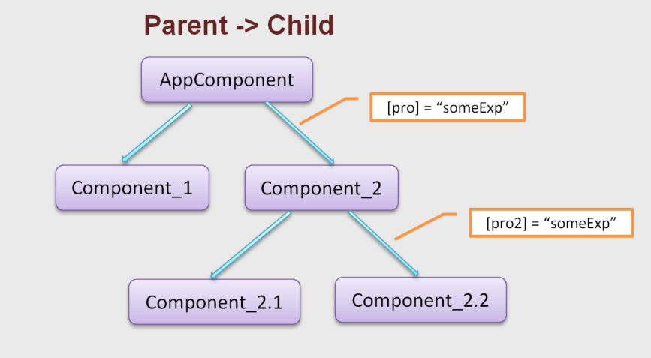
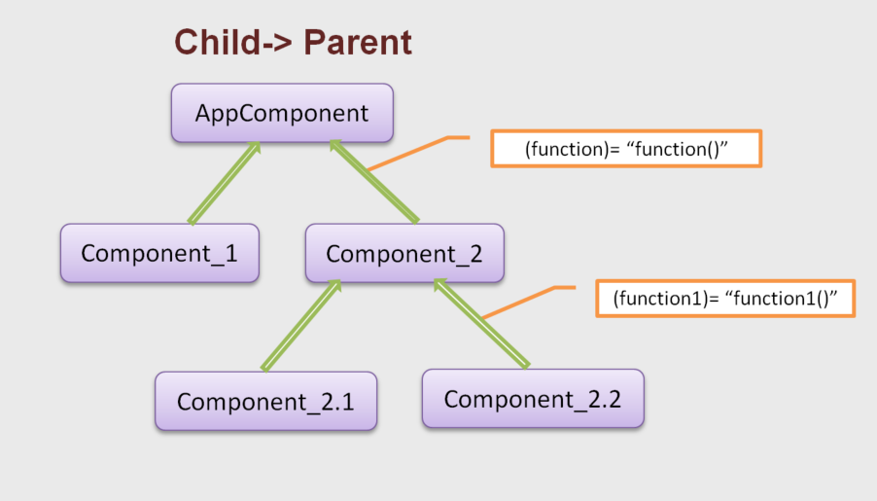
Component (9)
Component Communications.
Parent ⬄ Child Component
Example with Input/Output
https://plnkr.co/edit/5vm0JBxmcYgdB0TMaOmB?p=preview
Notes:
https://plnkr.co/edit/5vm0JBxmcYgdB0TMaOmB?p=preview

Slide 44
Component (10)
Component Communications.
Sibling Component - Use Service.
Sibling Component - Use Mediator Design Pattern
The Mediator acts as a middle
A component A sends data to mediator, which passes data to a component B
Component A and component B doesn’t know each other
A parent component can mediate of sibling’s communication

Slide 45
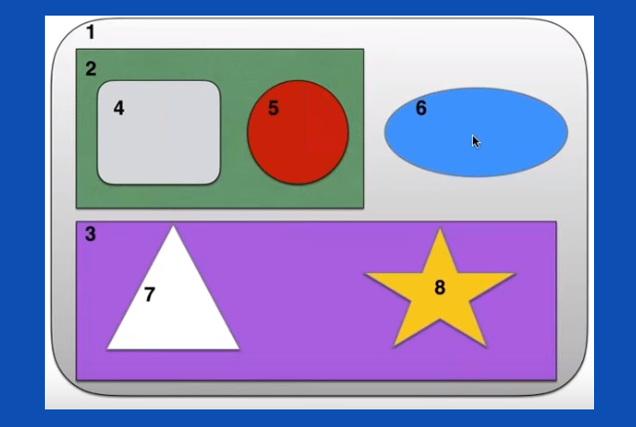
Component (11)
Component Communications.
Sibling Component - Use Mediator Design Pattern-Parent as Mediator
How CPN 7 can send data to CPN 6?
- 7 emits event to it’s parent is 3.
3 emits event to it’s parents is 1.
1 sends data to 6 by using input

Slide 46
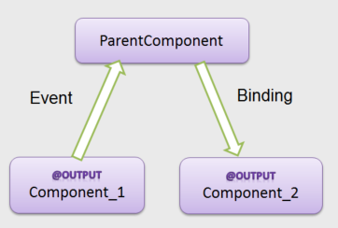
Component (12)
Component Communications
Sibling Component
https://plnkr.co/edit/Ait8j8Dw6mlvV6jhS7Oq?p=preview
Notes:
https://plnkr.co/edit/Ait8j8Dw6mlvV6jhS7Oq?p=preview

Slide 47
Component (12)
Component Communications
Communicating Between Components with Observable & Subject
Notes:
http://jasonwatmore.com/post/2016/12/01/angular-2-communicating-between-components-with-observable-subject
http://plnkr.co/edit/XqwwUM44NQEpxQVFFxNW?p=preview
https://plnkr.co/edit/FHIPt1?p=preview
https://hassantariqblog.wordpress.com/2016/12/03/angular2-difference-between-a-behavior-subject-and-an-observable/

Slide 48
Binding (7)
How does Angular handle binding?
As you know, Angular can detect when component data changes, and then automatically re-render the view to reflect that change. But how can it do so coz change can happen anywhere on the page and What is it that tells Angular “a change probably occurred in our application? Before we dive into these questions, let’s first think about what actually causes this change in our applications.
What cause changed?
Application state change is caused by three things:
Browser Events - User events like click, change, input, submit, …
XMLHttpRequests - E.g. when fetching data from a remote service
Timers - setTimeout(), setInterval()

Slide 49
Binding (8)
How does Angular 2 handle binding?
What cause changed?
They are all asynchronous. Which brings us to the conclusion that, basically whenever some asynchronous operation has been performed, our application state might have changed. This is when someone needs to tell Angular to update the view.
Who notifies Angular?
Zones take care of notifying Angular.

Slide 50
Binding (9)
How does Angular handle binding?
Zone.js - Overriding browser default mechanisms
What happens is that Angular at startup time will monkey-patch several low-level browser APIs, such as for example addEventListener, setTimeout…, which is the browser functions used to register all browser events, including click handlers.
To monkey-patch browser APIs, angular uses a library called Zone.js
Zone.js is a generic mechanism which we can use to add extra functionality to the browser. Angular uses Zones internally to trigger change detection
The following is a simplified conceptual snippet of what zone.js does at startup time.

Slide 51
Binding (10)
How does Angular handle binding?
Zone.js - Overriding browser default mechanisms
function zoneAwareAddEventListener() {...}
function zoneAwareRemoveEventListener() {...}
function zoneAwarePromise() {...}
function patchTimeout() {...}
window.prototype.addEventListener = zoneAwareAddEventListener; window.prototype.removeEventListener = zoneAwareRemoveEventListener; window.prototype.promise = zoneAwarePromise;
window.prototype.setTimeout = patchTimeout;

Slide 52
Binding (11)
How does Angular handle binding?
NgZone - Angular comes with its own zone called NgZone.
NgZone has few event emitters
When app is bootstrapped by bootstrap function, it creates a new NgZone
this._onTurnStartEvents = new EventEmitter(false); this._onTurnDoneEvents = new EventEmitter(false); this._onEventDoneEvents = new EventEmitter(false); this._onErrorEvents = new EventEmitter(false)

Slide 53
Binding (12)
How does Angular handle binding?
ApplicationRef - subscribes to the zone's events
A reference to an Angular application running on a page.
When ApplicationRef is created it subscribes to the zone's events, specifically onTurnDone
When events are triggered tick() function is run which loops through every component
this.zone.onTurnDone .subscribe(() => this.zone.run(() => this.tick())
this._changeDetectorRefs.forEach((detector) => detector.detectChanges());

Slide 54
Binding (13)
How does Angular handle binding?
detectChanges – Compare values
function checkBinding(throwOnChange, oldValue, newValue) {
if (throwOnChange) {
…..
}
else {
return !looseIdentical(oldValue, newValue);
}
}
function looseIdentical(a, b) {
return a === b || typeof a === "number" && typeof b === "number" && isNaN(a) && isNaN(b);
}

Slide 55
Binding (14)
How does Angular handle binding?
Change Detection
We now know when change detection is triggered, but how is it performed? In Angular, each component has its own change detector,
which is created at application startup time
_View_ChildComponent0.prototype.detectChangesInternal = function(throwOnChange) {
var self = this;
self.detectContentChildrenChanges(throwOnChange);
self.debug(2,1,8);
var currVal_0 = jit_interpolate5(1,'\n I am child component\n ',self.context.name,'\n ');
if (jit_checkBinding6(throwOnChange,self._expr_0,currVal_0)) {
self.renderer.setText(self._text_2,currVal_0);
self._expr_0 = currVal_0;
}
self.detectViewChildrenChanges(throwOnChange);
};

Slide 56
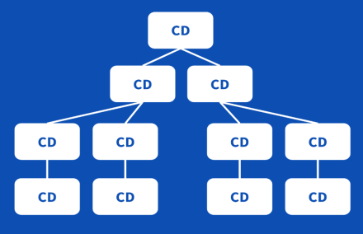
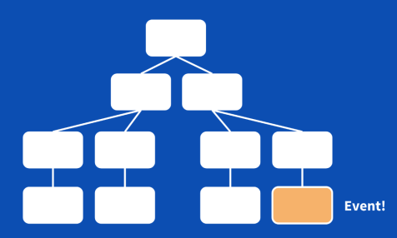
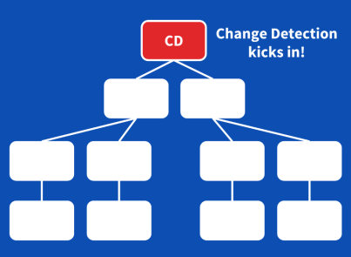
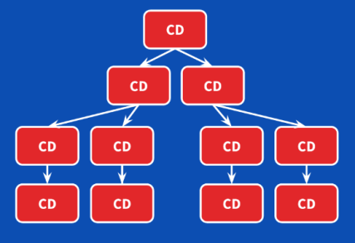
Binding (15)
How does Angular handle binding?
Change Detection
As we know, an Angular application consists of a component tree, the logical result is that we’re having a change detector tree too
Change Detection is always performed in the same order starting from root
By default, even if we have to check every single component every single time an event happens, Angular is very fast. It can perform hundreds of thousands of checks within a couple of milliseconds.

Slide 57
Binding (16)
How does Angular handle binding?
Change Detection – Trigger automatically
Trigger change detection from child component
https://plnkr.co/edit/iiUszT7dSPlGX16kXXBC?p=preview
Trigger change detection from parent component
https://plnkr.co/edit/fmn9ORNDcqi7aSKVpvFs?p=preview
Ex for performance
https://plnkr.co/edit/Zqhzp5akGI0tO8u476ib?p=preview
Notes:
Trigger change detection from child component
https://plnkr.co/edit/iiUszT7dSPlGX16kXXBC?p=preview
Trigger change detection from parent component
https://plnkr.co/edit/fmn9ORNDcqi7aSKVpvFs?p=preview
Ex for performance
https://plnkr.co/edit/Zqhzp5akGI0tO8u476ib?p=preview

Slide 58
Binding (17)
How does Angular 2 handle binding?
Change Detection – Trigger manually
As we know that, we can trigger change detection when Application state change is caused by three things and the things are handle by Zone automatically
Browser Events - User events like click, change, input, submit, …
XMLHttpRequests - E.g. when fetching data from a remote service
Timers - setTimeout(), setInterval()
So, without zones, we don’t get any change detection, so we don’t get any of the nice UI updates that we’d expect! So in case Application state change is caused outside the zone we need to trigger change detection manually
https://plnkr.co/edit/9MpwKqqUVa5hiexdIope?p=preview
Notes:
https://plnkr.co/edit/9MpwKqqUVa5hiexdIope?p=preview

Slide 59
Binding (18)
How does Angular 2 handle binding?
Change Detection – Turn On/Off
There could be special occasions where we do want to turn off change detection. To do so, we start by injecting ChangeDetectorRef into the component and use detach function to turn off the change detection and detectChanges function to turn on the change detection
We can turn off/on Change Detector at child component
https://plnkr.co/edit/qQ4CSmEtxxulteQqMKjg?p=preview
Or turn off/on Change Detector at parent component
https://plnkr.co/edit/prAzCnQKt7fDwRCGUymZ
In real application the data changes constantly, many times per second. For performance reasons, we want to check and update UI only once every 5 seconds
https://plnkr.co/edit/PHUcnynNzv5Z1kERvPXY?p=info

Slide 60
Binding (19)
How does Angular 2 handle binding?
Smarter Change Detection – OnPush Strategy
By default, change detection will run from the root to all the components every time an events happen in one of the components, it will check every component during the run because the application state has changed. Although it may seem terribly inefficient, the Angular 2 change detection system can go through hundreds of thousands of simple checks (the number are platform dependent) in a few milliseconds.
But there is a way we can tell it to run only on what really changed by using OnPush

Slide 61
Binding (20)
How does Angular 2 handle binding?
Smarter Change Detection – OnPush Strategy
OnPush means that the change detector will only run on a component or directive if one of the following occurs:
An input property has changed to a new value
An event fired in the component or directive
You manually tell the change detector to look for changes
The change detector of a child component or directive runs

Slide 62
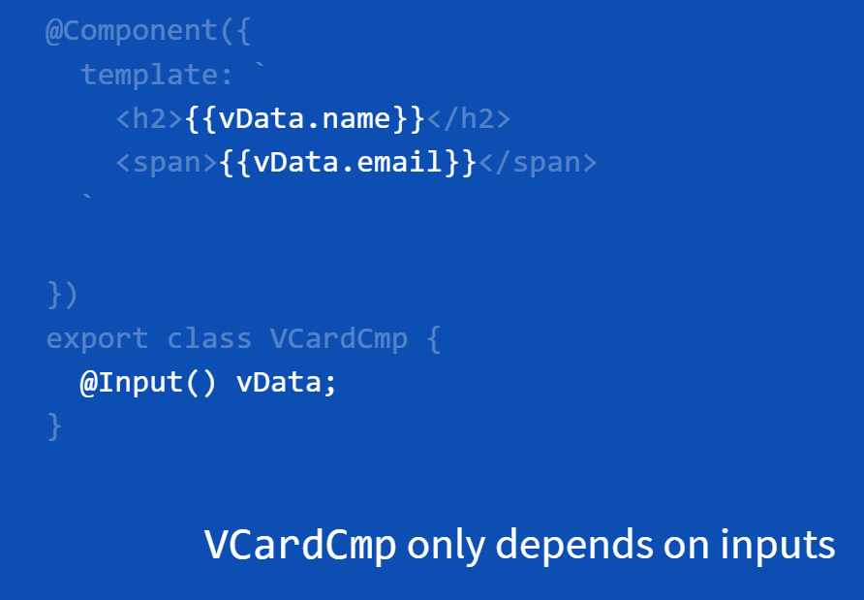
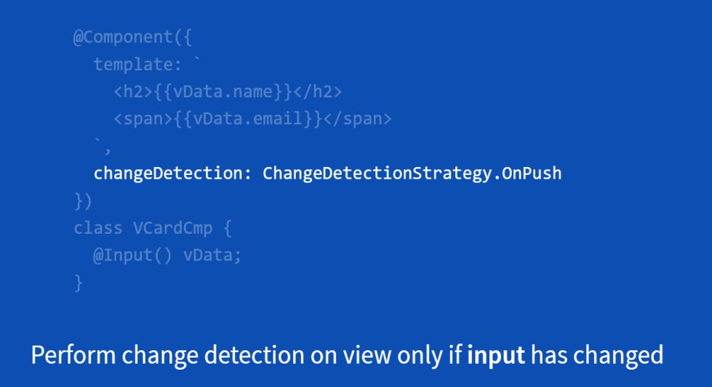
Binding (21)
How does Angular 2 handle binding?
Smarter Change Detection – OnPush Strategy
By using ChangeDetectionStrategy.OnPush , Angular can skip entire Change Detection subtrees when inputs properties don't change. Let look at a child component below

Slide 63
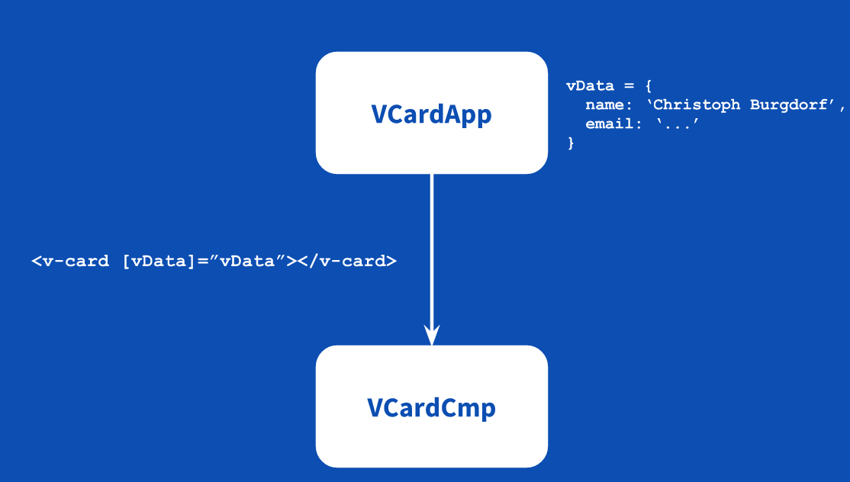
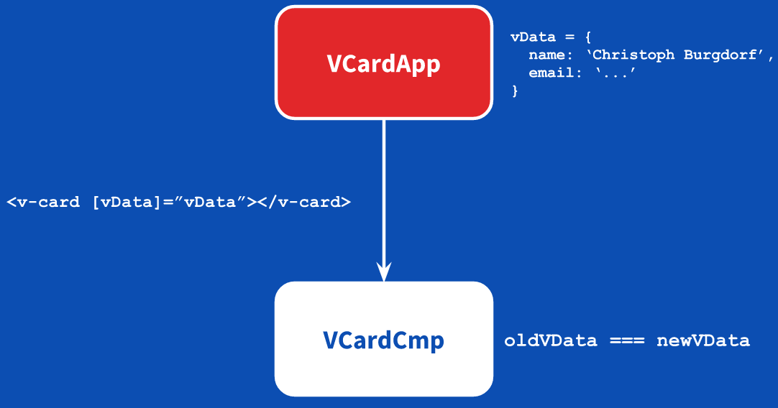
Binding (22)
How does Angular 2 handle binding?
Smarter Change Detection – OnPush Strategy

Slide 64
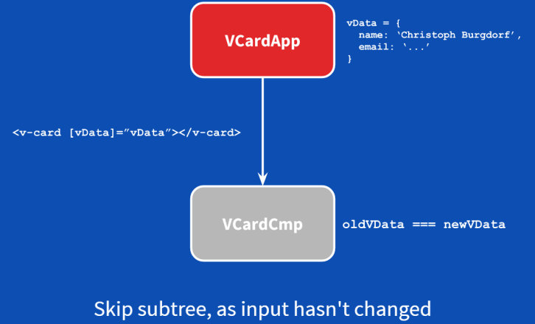
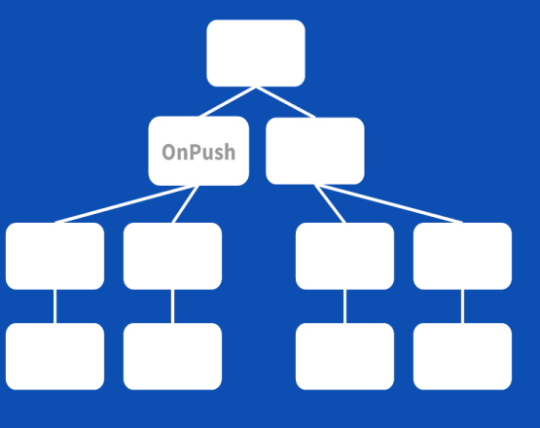
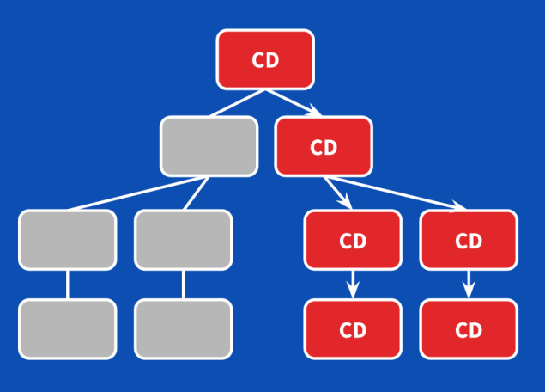
Binding (23)
How does Angular 2 handle binding?
Smarter Change Detection – OnPush Strategy
https://plnkr.co/edit/sYIRmEu5v5LIq001UcSn

Slide 65
Binding (25)
How does Angular 2 handle binding?
Smarter Change Detection – OnPush Strategy
Problems with Mutable Objects
As mentioned in example https://plnkr.co/edit/sYIRmEu5v5LIq001UcSn
, the name and email in child component doesn’t changed although we update the name and email like this:
this.person.name = 'le cao 1';
this.person.email = 'lecao1@harveynash.vn';
The reason is person is mutable object, we updated it without creating new person object, so change detection of child component doesn’t triggered.
To resolve that problem we use Immutable object .Primitives types like strings and numbers are immutable. We can freeze JavaScript objects and array to make them immutable, but a better option would be to use libraries like Immutable.js

Slide 66
Binding (24)
How does Angular 2 handle binding?
Smarter Change Detection – OnPush Strategy
To resolve that problem we use Immutable object .Primitives types like strings and numbers are immutable. We can freeze JavaScript objects and array to make them immutable, but a better option would be to use libraries like Immutable.js

Slide 67
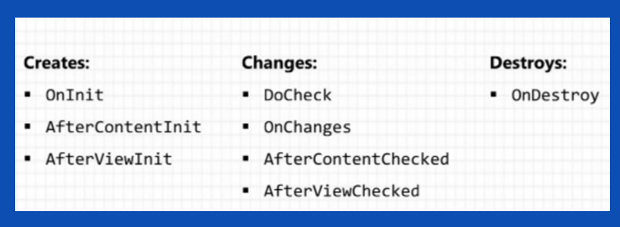
Component (8)
Component Lifecycle
A Component has a lifecycle managed by Angular itself. Angular manages creation, changing or destroy.
We can implement one or more of the Lifecycle Hook interface in the Angular core library.
Each interface has a single hood method whose name is the interface name with prefix with ng. For example the OnInit interface has a hook method named ngOnInit

Slide 68
Component (9)
Component Lifecycle
ngOnChange
Detect whenever @Input property changes
The ngOnChanges method takes an object that maps each changed property name to a SimpleChange object with the current and previous property values
https://plnkr.co/edit/XtGgwbbMpuRyBIJk8ucu
ngOnChanges won’t be triggered when we mutate a (non-immutable) JavaScript object. Instead it triggers only when we reference-change the data-bound input property.
How can I get to know about changes in my objects? DoCheck can be of help here.

Slide 69
Component (11)
Component Lifecycle
ngDoCheck
ngDoCheck() is invoked whenever change detection is run
We can use the DoCheck hook to detect changes that Angular doesn't catch on its own.
https://plnkr.co/edit/yUEWVeRpj8rMCOx4q1Zf?p=info

Slide 70
Component (12)
Component Lifecycle
ngOnInit:
The ngOnInit is called directly after the constructor and before the ngOnChange is triggered for the first time
Runs after Angular sets the input properties
ngOnInit performs complex initializations shortly after construction
ngOnInit often fetches data for the component
Constructor : constructor is a default method runs (by default) when component is being constructed. When you create an instance of a class that time also constructor(default method) would be called
If our component is based on any dependencies, the constructor is the best place to inject those dependencies.
https://plnkr.co/edit/ShrpiXQf3GG7DpMr7l6b?p=preview

Slide 71
Component (13)
Component Lifecycle
ngOnDestroy:
Put cleanup logic in ngOnDestroy, the logic that must run before Angular destroys the directive/Component.
This is the time to notify another part of the application that this component is going away.
This is the place to free resources that won't be garbage collected automatically. Unsubscribe from observables and DOM events. Stop interval timers. Unregister all callbacks that this directive registered with global or application services
https://plnkr.co/edit/J4WankFdGrYojF2gc00p?p=info

Slide 72
Component (14)
Component Lifecycle
Before we talk about AfterViewInit, AfterViewChecked , AfterContentInit, AfterContentChecked we need to know what is ViewChild and ContentChild
@ ViewChild
The @ViewChild decorator provide access to the classes of child component from the containing(parent) component.
@ ViewChild is a ways to achieve the interaction between the components
Simply is that if the parent component want to access child component and their methods we use @ ViewChild
https://plnkr.co/edit/rAVzjBETNTxDFEMyvn62?p=preview

Slide 73
Component (15)
Component Lifecycle
AfterViewInit and AfterViewChecked
ngAfterViewInit - after component's view(s) are initialized
ngAfterViewChecked - after every check of a component's view(s)
https://plnkr.co/edit/fpIfgl0gzRU3WFkh52Ta

Slide 74
Component (17)
Component Lifecycle
@ContentChild
It works the same way as the equivalent @ViewChild, however, the key difference is that @ContentChild select from the projected content within the component.
Simply if we include a component between another component label instead of regular HTML elements we use ContentChild to get component contained in it
https://plnkr.co/edit/tZJywVImm6ume1iDgSyP?p=preview
<parent-component>
<child-component></child-component> </parent-component>

Slide 75
Component (16)
Component Lifecycle
AfterContentInit and AfterContentChecked
ngAfterContentInit - after component content initialized
ngAfterContentChecked - after every check of component content
https://plnkr.co/edit/s4SJv0jwptA68e5FH9mt?p=preview

Slide 76
Component (17)
Component Lifecycle
ViewChild versus ContentChild
To understand the different between ViewChild and ContentChild, let look at example as below
https://plnkr.co/edit/yajmPFV0QBbMCQ4MlzBQ?p=preview
From example we can we can say that the content child of the given component is the child element that are nested within the component’s host element. In contrast, the view child of the given component is the element used inside template

Slide 77
Component (18)
Component Lifecycle
Lifecycle Hooks are executed in the following order.
NgOnChanges
NgOnInit
NgDoCheck
NgAfterContentInit
NgAfterContentChecked
NgAfterViewInit
NgAfterViewChecked
NgOnDestroy

Slide 78
Component (19)
Component Transclusion (Projection)
Projection is a very important concept in Angular. It enables developers to build reusable components and make applications more scalable and flexible. To illustrate that, suppose we have a ChildComponent like:
@Component({
selector: 'child',
template: `<h4>Child Component</h4>
{{ childContent }} `
})
export class ChildComponent {
childContent = "Default content";
}

Slide 79
Component (20)
Component Transclusion (Projection)
What should we do if we want to replace {{ childContent }} to any HTML that provided to ChildComponent? One tempting idea is to define an @Input containing the text, but what if you wanted to provide styled HTML, or other components? Let's say we have a component. It has a header, body, and footer.
The component layout (3 sections) and color (grey background for header and footer) are always fixed.
The header and footer always allow text.
Any content is allowed in body.

Slide 80
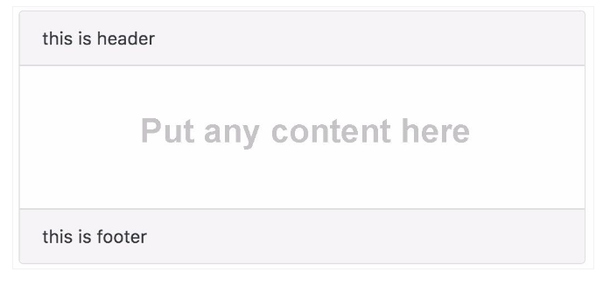
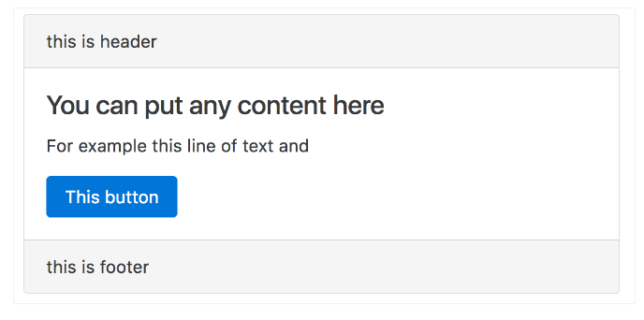
Component (21)
Component Transclusion (Projection)

Slide 81
Component (22)
Component Transclusion (Projection)
How can we add dynamic content to the body section? The answer is Content Projection
Content Project is a way to let you define a fixed view template, and at the same time allow you to define a slot for dynamic content by using <ng-content> tag.
https://plnkr.co/edit/MZ3LBm7bOZzpbpPdDKWU?p=preview
Example above is Single Projection
But what if we have multiple <ng-content></ng-content> and want to specify the position of the projected content to certain ng-content? We need a projecting multiple

Slide 82
Component (23)
Component Transclusion (Projection)
Projection Seletor
Before talk about multi projection, we need to talk about Projection Selector. <ng-content> accepts a select attribute, which allow us to sort of name our part need to be added, it allow us to define the selector of our part
https://plnkr.co/edit/con7TlAnjhT6j3L5eZww?p=preview
On example above we add select=[part-body]. The square bracket [] means attribute. It means "Replace me only if the element has part-body attribute". We can also use attribute with value
https://plnkr.co/edit/MlDENj6CY2XN1miBrrKU?p=preview
Another type we can use is CSS CLASS SELECTOR
https://plnkr.co/edit/2wWxonq75H3SubiGIHgS?p=preview

Slide 83
Component (24)
Component Transclusion (Projection)
Projection Seletor
We can use multiple attributes or css classes
https://plnkr.co/edit/gzn5gQDrolnZAdmR5LWr?p=preview
We can an HTML tag
https://plnkr.co/edit/yxDJCS3bxQhfosR4nGJ8?p=preview

Slide 84
Component (25)
Component Transclusion (Projection)
Multi Projection
By using the select attribute, we can define multiple projection
https://plnkr.co/edit/K3kWHCajm1ff0A30wTS0?p=preview
https://plnkr.co/edit/QqsSTVOoxd4WpH9M0zCB?p=info
Multi Projection – ngFor *****

Slide 85
Directives (1)
What is Angular 2 Directive all about?
As we know that angular 2 has 3 types of directive
Component is directive has template and the @Component decorator is actually a @Directive decorator extended with template-oriented features.
Structural directives alter layout by adding, removing, and replacing elements in DOM.
Attribute directives alter the appearance or behavior of an existing element. In templates they look like regular HTML attributes

Slide 86
Directives (2)
Structural directive
There‘re built-in structural directives that we often use as : ngIf, ngFor, ngSwitch…
<div *ngIf=“valid">{{ hero }}</div>
<div *ngFor="let item of items">{{ item}}</div>
<div [ngSwitch]="status">
<template [ngSwitchWhen]="'in-mission'">In Mission</template> <template [ngSwitchWhen]="'ready'">Ready</template>
<template ngSwitchDefault>Unknown</template>
</div>

Slide 87
Directives (3)
Structural directive
NgIf
It takes a boolean and makes an entire chunk of DOM appear or disappear.
In order to have an else clause as part of an ngIf statement, you would have to instead create another ngIf statement with the negation of the first statement:
But now we can define an else clause with the reference name for a template that we define with ng-template:
<div *ngIf="likeThis"> Like this! </div>
<div *ngIf="!likeThis"> Like that! </div>
<div *ngIf=" condition; else noCar"> Nice car! </div>
<ng-template #noCar> Call a Uber. </ng-template>

Slide 88
Directives (4)
Structural directive
NgIf
Local Variable Assignment
Often the resulting value of an if statement won’t just be the boolean true or false but will instead be a value that you may want to reference easily. With the new ngIf you can easily assign the result of the if statement to a local variable. For example, our things object looks like this in our component class:

Slide 89
Directives (5)
Structural directive
NgIf
ngIf with Async Pipe
With the Async pipe we get the benefit of Angular auto subscribing and unsubscribing with our Observables when the component is created and destroyed.
https://plnkr.co/edit/72AZ7dQ54EeQ1hDO5kv8?p=preview
Notes:
https://coryrylan.com/blog/angular-async-data-binding-with-ng-if-and-ng-else

Slide 90
Directives (6)
Structural directive
Iteration with ngFor
When we have a list of items, we can use the ngFor directive within our component's template to create identical DOM elements for each item. It can be used several ways, such as:
https://plnkr.co/edit/evsQC2K8zbrsLUBoF1T6?p=preview
<li *ngFor="let item of items; let i = index">...</li>
<li template="ngFor let item of items; let i = index">...</li>
<template ngFor let-item [ngForOf]="items" let i="index"><li>...</li></template>

Slide 91
Directives (7)
Structural directive
Iteration with ngFor
Available local variables
You can also set local variables for the following exported values: index, first, last, evenand odd. index will return the current loop index, and the other values with provide a boolean indicating if the value is true or false. For example:
Async Pipe
https://plnkr.co/edit/IKvh1tBArBihi7hZa40f?p=preview

Slide 92
Directives (7)
Attribute directive
Examples of built-in attribute directives that ship with Angular 2 are ngStyle and ngClass.
NgStyle
We can set inline styles dynamically, based on the state of the component. Binding to NgStyle lets us set many inline styles simultaneously.
https://plnkr.co/edit/nHQhrvngdp7FnCxKI8yR?p=preview
NgClass
NgClass to add or remove several classes simultaneously.
https://plnkr.co/edit/fJAgsJWaWD3RKrrqwCLx

Slide 93
Directives (6)
Creating a Directive
The process of creating a directive is very similar to creating a component: We define a new class and decorate it. We need the @Directive decorator with a selector
Structural directive
We declare a constructor that injects two things:TemplateRef and ViewContainerRef. TemplateRef points to our template and ViewContainerRef will handle creating the view and attaching it to the container.
Specify the name of the public input property for binding @Input() (typically the name of the directive itself).
https://plnkr.co/edit/o3rBxpHUbvMatPXuAJv4

Slide 94
Directives (7)
Creating a Directive (**)
Attribute directive
We need the ElementRef to inject into the directive's constructor so we can access the DOM element. ElementRef is a service that grants us direct access to the DOM element through its nativeElement property.
https://plnkr.co/edit/oxwC7IKhrhvDL08kZ41U
Respond to user action
We apply the @HostListener decorator to methods which are called when an event is raised
https://plnkr.co/edit/SwGI0KkDyqjJjSEd616y?p=preview

Slide 95
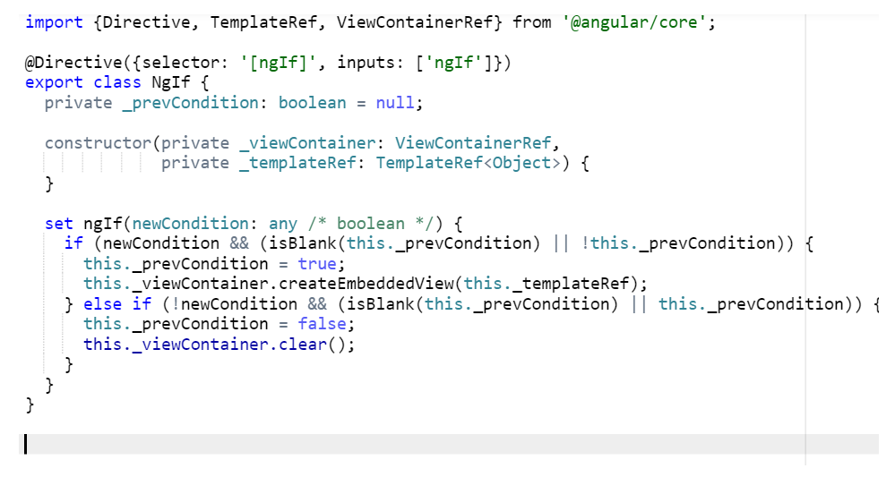
Directives (8)
Creating a Directive
Let look at how built in directive created

Slide 96
Form (1)
What is Angular 2 Forms all about?
How to keep track of the global form state
Know which parts of the form are valid and which are still invalid
Properly displaying error messages to the user so that the user knows what to do to make the form valid
Template Driven Forms, or the Angular 1 way
Model Driven Forms

Slide 97
Form (2)
Template Driven Forms?
form
Let’s start off with a simple login form that asks for some user data:
<form>
<label>Firstname:</label>
<input type="text">
<label>Lastname:</label>
<input type="text">
<label>Street:</label>
<input type="text">
<label>City:</label>
<input type="text">
<button type="submit">Submit</button>
</form>

Slide 98
Form (3)
Template Driven Forms?
NgForm directive
A simple HTML form with input controls for a name and an address of a user. Nothing special going on here. The special thing that we can’t see that Angular comes with a directive ngForm that matches the<form> selector
NgForm.decorators = [
{ type: _angular_core.Directive, args: [{
selector: 'form:not([ngNoForm]):not([ngFormModel]),ngForm,[ngForm]',
providers: [formDirectiveProvider],
host: {
'(submit)': 'onSubmit()',
},
outputs: ['ngSubmit'],
exportAs: 'ngForm'
},] },
];

Slide 99
Form (4)
Template Driven Forms?
NgForm Directive
ngForm provides us information about the current state of the form including
A JSON representation of the form value
Validity state of the entire form
Accessing the ngForm instance?
When ngForm that matches the<form> selector, so in fact, our form element already has an instance of ngForm applied. And now we can use Angular’s local variable mechanism to access the ngForm instance
<form #myForm="ngForm"> ... </form>

Slide 100
Form (5)
Template Driven Forms? (**)
NgForm Directive
Submitting a form and Accessing its value?
We can now use myForm to access the form’s value and it’s validity state. All we have to do is to add a handler to the form’s submit event and pass it the form’s value.
https://plnkr.co/edit/D1SnuiVMFWtEWrFj4wlB
Running above example we realize, that the form’s value is an empty object. Because we haven’t register controls on form.
<form #myform="ngForm" (ngSubmit)=“doSomething(myForm.value)"> ... </form>

Slide 101
Form (6)
Template Driven Forms?
ngModel Directive
In order to register form controls on an ngForm instance, we use the ngModel directive.
<form #myform="ngForm" (ngSubmit)=“doSomething(myForm.value)">
<label>Firstname:</label>
<input type="text" name="firstname" ngModel>
…….
</form>

Slide 102
Form (7)
Template Driven Forms?
ngModel Directive
If we now enter some values and submit the form, we’ll see that our application will log something like this:
https://plnkr.co/edit/7bIXSLkTYIEVGVOs58BY?p=preview
{
firstname: ‘Le',
lastname: ‘Cao',
street: ‘Cong Hoa',
city: HCM'
}

Slide 103
Form (8)
Template Driven Forms?
ngModelGroup Directive
What if we actually want to have some more structure and make our form object look like this
{
name: {
firstname: ‘Le', lastname: ‘Cao',
},
address: {
street: ‘Cong Hoa', city: ‘HCM‘
}
}

Slide 104
Form (9)
Template Driven Forms
ngModelGroup Directive
ngModelGroup enables us to semantically group our form controls.
https://plnkr.co/edit/QsRDfg6UpWJKUjvooP94?p=preview
<fieldset ngModelGroup="name">
<label>Firstname:</label>
<input type="text" name="firstname" ngModel>
..
</fieldset>
<fieldset ngModelGroup="address">
<label>Street:</label>
<input type="text" name="street" ngModel>
…
</fieldset>

Slide 105
Form (10)
Template Driven Forms
ngModelGroup Directive
So far we’ve used ngModel as attribute directive without any value, but we might want to use it with an expression to bind an existing domain model to our form. One thing we can do is to apply property binding using the brackets syntax, so we can bind an existing value to a form control using one-way binding:
https://plnkr.co/edit/AT1NcLzvQqkeLGazjnK9?p=preview
In addition, we can of course use ngModel and two-way data binding, in case we want to reflect the model values somewhere else in our template:
https://plnkr.co/edit/SgH34tm9eZWIu89sXp0H

Slide 106
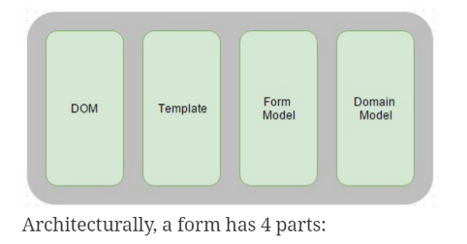
Form (11)
Model Driven Forms
Before we look at why you would want to use model driven forms, what do we mean by model driven forms?

Slide 107
Form (12)
Model Driven Forms
DOM. This is where the form is rendered to!
Template. This defines how the fields are laid out in the DOM
Form Model. This defines the fields on the form and some of the associated UI logic such as what the client side validation rules are and what the default values are
Domain Model. This contains the fields and their values
In angular 1, the form model was hidden from us – angular creates this for us from the template. In angular 2 we can create the form model using the low level APIs for FormGroup and FormControl or higher level API FormBuilder

Slide 108
Form (13)
Model Driven Forms
So, why would we want to do this? This sounds like extra work – if angular 1 did this for us, why would we now want to write that code? There are a number of reasons …
Maintainability. When fields on the form depend on conditions it may be easier to read and debug imperative code for this rather than declarative code in the template
More unit testable. More of the UI logic can now be abstracted and totally independent of the DOM, which makes unit testing easier
The Model Driven approach removes validation logic from the template, keeping the templates clean of validation logic.

Slide 109
Form (14)
Model Driven Forms
Low APIs : FormGroup and FormControl
Let’s start off again with the same form we used in our previous article, a form to register a new user on a platform:
<form>
<label>Firstname:</label>
<input type="text">
<label>Lastname:</label>
<input type="text">
<label>Street:</label>
<input type="text">
<label>City:</label>
<input type="text">
<button type="submit">Submit</button>
</form>

Slide 110
Form (15)
Model Driven Forms
FormGroup, formGroupName, formControl , and formControlName
Now, to make this form model-driven, what we need to do is to create a form model that represents that DOM structure in our component. One way to do that is to use the low level APIs for FormGroup and FormControl. FormGroup always represents a set of FormControls.
To bind forms we use formGroup, formGroupName and formControlName
https://plnkr.co/edit/ghcgXUs4txe3mGlz0XTF
https://plnkr.co/edit/waDkfbf97ywKfmnoFGD7?p=preview

Slide 111
Form (16)
Model Driven Forms
FormBuilder
By using FormGroup, FormControl the creation of our form model looks quite wordy as we have to call new FormGroup() and new FormControl several times to construct the model. So we can use a higher level API that makes this task a bit more pleasant. It’s FormBuilder
FormBuilder is like a factory that creates FormGroup’s and FormControl’s for us. All we need to do is to import it and us its .group() method
https://plnkr.co/edit/fxtII7AOzzYKtN0gXrEj?p=preview

Slide 112
Form- Validation (1)
Built-in Validators
required - Requires a form control to have a non-empty value
minlength - Requires a form control to have a value of a minimum length
maxlength - Requires a form control to have a value of a maximum length
pattern - Requires a form control’s value to match a given regex
Example apply Built-in validator for template driven form
https://plnkr.co/edit/nFsrHa8HNZsfebxz6QUH?p=info
Example apply Built-in validator for model driven form
https://plnkr.co/edit/yk6FxNDtAU3mxzEBMfy6?p=info
https://plnkr.co/edit/rh48EpYgw73LVQcsralV?p=preview

Slide 113
Form- Validation (2)
Building a custom validator for model driven form
In it’s simplest form, a validator is really just a function that takes a Control and returns either null when it’s valid, or and error object if it’s not.
https://plnkr.co/edit/Du7qHfNnq0czdkf9gXna?p=preview
Building custom validator directives
Now that we’re able to add our custom validator to our form controls imperatively when building model-driven forms, we might also enable our validator to be used in template driven forms. In other words: We need a directive.
https://plnkr.co/edit/SoRO2vbVA1vUWeTXoJ7n?p=preview

Slide 114
Form- Validation (4)
Error Message
The easy way we can access the validity state of a form control like this to display error message
<p *ngIf=“myForm.controls.firstname.errors.required">This field is required!</p>
https://plnkr.co/edit/cfGDlq48AYL5M3m0S5uG?p=info
Or we can build a custom messages component similar to ng1’s ngMessages.
https://plnkr.co/edit/nVAxH5pQ89iiOEl94HQY?p=preview

Slide 115
Router-Basic (1)
<base href>
The Component Router uses the browser's history.pushState for navigation. We must add a <base href> element tag to the index.html to make pushState routing work.Add the base element just after the <head> tag.
<base href="/">
Configure the routes for the Router (**)
Routes : The Routes is an array of route definitions.
Each Route definition has two parts:
path: the router matches this route's path to the URL in the browser address bar
component: the component that the router should create when navigating to this route

Slide 116
Router-Basic (2)
Configure the routes for the Router
Register routing in the root NgModule
import {Routes, RouterModule } from '@angular/router';
Export const routes: Routes = [
{ path: ‘ home', component: HomeComponent }
{ path: 'about', component: AboutComponent }
];
export const routing = RouterModule.forRoot(appRoutes);
Notes:
https://gist.github.com/fernandohu/122e88c3bcd210bbe41c608c36306db9

Slide 117
Router-Basic (3)
RouterLink
The directive for binding a clickable HTML element to a route. RouterLink takes care of generating an href attribute for us that the browser needs to make linking to other sites work. Clicking an anchor tag with a routerLink directive that is bound to a string or a Link Parameters Array triggers a navigation.
RouterOutlet
The directive (<router-outlet>) to tell Angular where to load the component we route to
RouterLinkActive
The directive for adding/removing classes from an HTML element when an associated routerLink contained on or inside the element becomes active/inactive.
https://plnkr.co/edit/MPAALPHfTEwOKsp1mTJQ

Slide 118
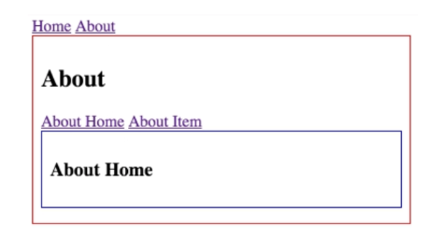
Router-Nested Child Routes (1)
Child/Nested routing is a powerful new feature in the new Angular 2 router. We can think of our application as a tree structure, components nested in more components. We can think the same way with our routes and URLs.

Slide 119
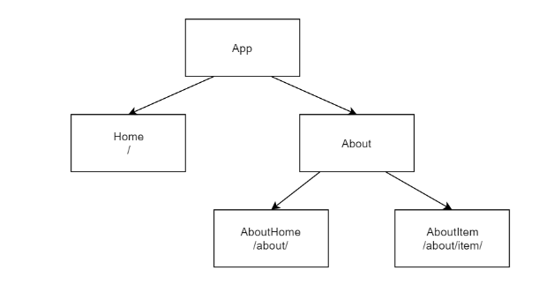
Router-Nested Child Routes (2)
So as above we can see the About view has its own router-outlet highlighted in blue. The about view also has its own links that navigate between two nested about child components. We can think of this as a tree structure.

Slide 120
Router-Nested Child Routes (2)
We use children in Router to create nested routes
https://plnkr.co/edit/rEPPFREOKWiFENXVhGWe
export const routes: RouterConfig = [
{ path: '', redirectTo :'home', pathMatch :'full' },
{ path: '', component: HomeComponent }
{ path: 'about', component: AboutComponent,
children: [
{ path: '', redirectTo :'abouthome', pathMatch :'full' },
{ path: '', component: AboutHomeComponent},
{ path: 'item', component: AboutItemComponent } ] } ];

Slide 121
Route Parameters (1)
Route-query parameters allow us to pass values in our url to our component so we can dynamically change our view content.
prefer a route parameter when
the value is required.
the value is necessary to distinguish one route path from another.
prefer a query parameter when
the value is optional.
the value is complex and/or multi-variate.

Slide 122
Route-Query Parameters (2)
Access Parameters
A component that we route to has access to something that Angular calls the ActivatedRoute. An ActivatedRoute is an object that contains information about route parameters, query parameters and URL fragments
Ex route parameter
https://plnkr.co/edit/0ITlZ91BtIhIiRT2HCO8?p=preview
Ex query parameter
https://plnkr.co/edit/rotJQn4WZUOKmSVK7x94?p=preview

Slide 123
Route- Going Back To View
In addition to being able to use the routerLink directive to control the navigation of your application, you can also access the router from your components using the Router service.
http://plnkr.co/edit/WEGrOLPyJNCeibueAFlM?p=preview

Slide 124
Route- Authen - confirming navigation with guards (2)
At the moment, any user can navigate anywhere in the application anytime.
That's not always the right thing to do.
Perhaps the user is not authorized to navigate to the target component.
Maybe the user must login (authenticate) first.
Maybe we should fetch some data before we display the target component.
We might want to save pending changes before leaving a component.
We might ask the user if it's OK to discard pending changes rather than save them.
We can add guards to our route configuration to handle these scenarios.
if it returns true, the navigation process continues
if it returns false, the navigation process stops and the user stays put

Slide 125
Route- Authen - confirming navigation with guards (2)
The router supports two kinds of guards:
CanActive to prevent navigation to a route -requiring authentication
http://plnkr.co/edit/DYS8llnl6787yfzYClSS?p=preview
CanDeactave to prevent navigation away from the current route - handling unsaved changes
http://plnkr.co/edit/1hQ6Bh4TXSWSCSQH9IIB

Slide 126
Route- Revolve- pre-fetching component data (***)
When we use a real api to get data, there may be some delay in when the data we want to display gets returned. We don't want to display a blank component until the data loads in this situation.
http://plnkr.co/edit/eQMvhZhGm7ImcTFZ4iOt?p=preview
We'd like to pre-fetch data from the server so it's ready the moment our route is activated. We'd also like to handle the situation where our data fails to load or some other error condition occurs.
Notes:
https://blog.thoughtram.io/angular/2016/10/10/resolving-route-data-in-angular-2.html

Slide 127
Route -Multi Routers -Lazy loading modules with the Router
Multi Routers
http://plnkr.co/edit/4qiMgfsBrmFSdNkBjGq6?p=preview
Non Lazy Loading Modules
http://plnkr.co/edit/4SutwCD7miLmtU9luwOb?p=preview
Lazy Loading Modules
http://plnkr.co/edit/Ju4Tbs4GnXEeN8B48qf3?p=preview

Slide 128
Dependency Injection (1)
Dependency injection is an important application design pattern. Angular has its own dependency injection framework
Why dependency injection?
Let's start with the following simple code.
export class Invoice {
public product: Product;
constructor() {
This.product = new Product();
}
createShipment(product);
}

Slide 129
Dependency Injection (2)
Why dependency injection?
The function createShipment() depends on the existence of an instance of the Product object. In other words, the function createShipment() has a dependency: Product.
Our Invoice creates Product inside its constructor. What's the problem? The problem is that our Invoice class is easy to be broken, inflexible, and hard to test.
What if the Product class evolves and its constructor requires a parameter? Our Invoice is broken and stays broken until we rewrite it along the lines of this.product = new Product(theNewParameter).
Product changes, our Invoice class must change. That makes Invoice easy to be broken

Slide 130
Dependency Injection (3)
Why dependency injection?
What if we want to put a different brand of Product on our Invoice. We're locked into whatever brand the Product class creates. That makes our Invoice inflexible.
When we write tests for our Invoice we're at the mercy of its hidden dependencies. Is it even possible to create a new Product in a test environment? How do we know how many dependencies in Product class? When we can't control the dependencies, a class becomes difficult to test.

Slide 131
Dependency Injection (5)
Why dependency injection?
In our code sample it’s an easy change, but what if the function createShipment() has three dependencies (e.g. product, shipping company, and fulfillment center) and each of these dependencies has it’s own dependencies?
How can we make Invoice more robust, flexible, and testable? Would it be possible to ask someone to create instances of dependencies (with their dependencies) for us? YES. IT’S dependency injection

Slide 132
Dependency Injection (6)
What is dependency injection?
The Dependency Injection pattern is about: if an object A depends on the object of type B, the object A won’t explicitly instantiate the object B (as we did with the new operator above), but rather will get it injected from the operational environment
In other words, the object A just needs to declare, “I need an object of type B, could someone please give it to me?” The object A does not request a specific implementation of the object and will be happy as long as the injected object is of type B.

Slide 133
Dependency Injection (7)
Angular 2 dependency injection?
Angular offers a mechanism that helps registering and instantiating component dependencies. It helps in writing code in a loosely coupled way and makes your code more testable and reusable.
Loose coupling and reusability
Say you have a ProductComponent that gets products using the ProductService class. Without DI ProductComponent needs to know how to instantiate the class ProductService. It can be done by multiple ways, e.g. using new, calling getInstance() on some singleton object, or maybe invoking a createProductService() on some factory class. In any case ProductComponent becomes tightly coupled with ProductService.

Slide 134
Dependency Injection (8)
Angular 2 dependency injection?
Loose coupling and reusability
If you need to reuse the ProductComponent in another application that uses different service for getting product details, you’d need to modify the code (e.g. productService = new AnotherProductService()). DI allows to decouple application components by sparing them from the need to know how to create their dependencies.
Testability
DI increases testability of your components in isolation. You can easily inject mock objects where if their real implementations are not available or you want to unit-test your code

Slide 135
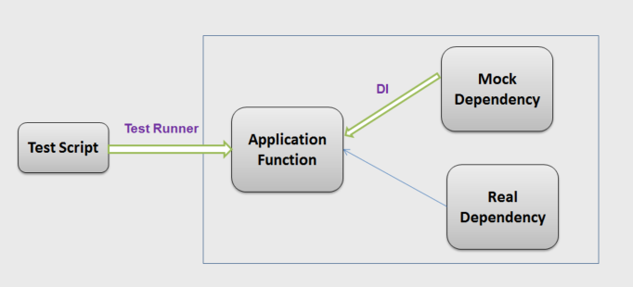
Dependency Injection (9)
Angular 2 dependency injection?
Testability

Slide 136
Dependency Injection (10)
Angular 2 dependency injection?
The DI in Angular 2 basically consists of three things:
Injector -
Each component has an Injector capable of injecting objects into other components. An injector knows how to inject one object of the specified type into the constructor of another.
Any Angular application is hosted by some root component, so you always have a root injector available.
We don't have to create an Angular injector. Angular creates an application-wide injector for us during the bootstrap process.
We do have to configure the injector by registering the providers that create the services our application requires.

Slide 137
Dependency Injection (11)
Angular 2 dependency injection?
The DI in Angular 2 basically consists of three things:
Provider - A provider is like a recipe that tells the injector how to create an instance of a dependency. Providers allows you to map a custom type to a concrete implementation of this type
Dependency - A dependency is the type of which an object should be created.

Slide 138
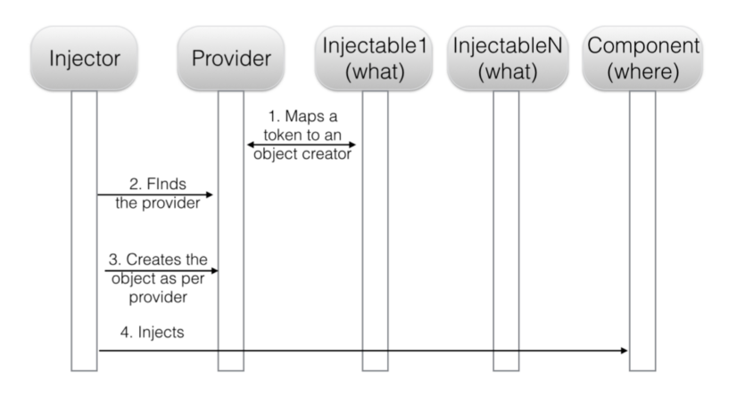
Dependency Injection (12)
Angular 2 dependency injection?
The sequence diagram of the injecting process.

Slide 139
Service (1)
What is Service?
Service is a class that encapsulates some sort of functionality as login, logger, getdata … and provides it as a service for the rest of your application.
If you have an Angular 1 background you’ll welcome this simplification in the Angular conceptual model: there’s no more service/factory/constant/provider.. In Angular 2 there’s only services, and they are just classes.
import { Product } from 'app/product';
export class ProductService{
getAll() : Product[] {
return [ {id:1, name: 'iPhone 7', description: '7-inch screen', price: 249.99}…]; }}

Slide 140
Dependency Injection- Service(1)
Provider configurations
Injector providers
A provider provides the concrete, runtime version of a dependency value. The injector relies on providers to create instances of the services that the injector injects into components and other services.
We must register a service provider with the injector, or it won't know how to create the service.

Slide 141
Dependency Injection- Service (2)
Register a Service into Component
http://plnkr.co/edit/KSofXT7KdSBO0gr6ZGV0?p=preview
With about example, our ProductService is very simple. It doesn’t have any dependencies of its own. What if it had a dependency? What if it reported its activities through a logging service? We'd apply the same constructor injection pattern, adding a constructor that takes a Logger parameter.
We will get the error: “Can't resolve all parameters for ProductService: (?).”
export class ProductService {
constructor (private logger: Logger){}
getProduct() { this.logger.log('Get product'); return new Product( 0, "iPhone 7", 249.99,"The latest iPhone, 7-inch screen" ); } }

Slide 142
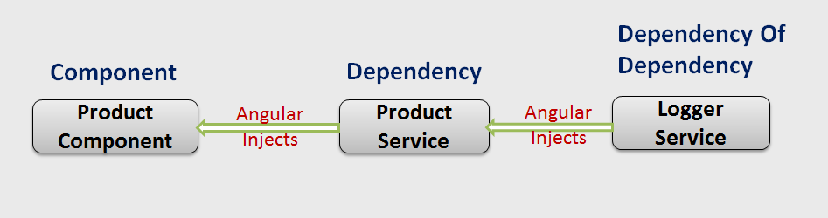
Dependency Injection- Service (2)
Register a Service into Component

Slide 143
Dependency Injection- Service (3)
When the service needs a service
If a service have dependencies of its own we have to use @Injectable() decorator . @Injectable() marks a class as available to an injector for instantiation.
SUGGESTION: ADD @INJECTABLE() TO EVERY SERVICE CLASS
We recommend adding @Injectable() to every service class, even those that don't have dependencies and, therefore, do not technically require it. Here's why:
Future proofing: No need to remember @Injectable() when we add a dependency later.
Consistency: All services follow the same rules, and we don't have to wonder why a decorator is missing.
http://plnkr.co/edit/YqOosLeyQvUKFsGDHBRg?p=preview

Slide 144
Dependency Injection- Service (4)
Registering providers in an NgModule
a provider in an NgModule is registered in the root injector. That means that every provider registered within an NgModule will be accessible in the entire application.
On the other hand, a provider registered in an application component is available only on that component and all its children.

Slide 145
Dependency Injection- Service(5)
Provider configurations
https://angular.io/guide/dependency-injection

Slide 146
Communicate with a server- Asynchronous (1)
Story
On one day, I was planning for a trip to Vung Tau. So I called the tour coordinator who makes the arrangements to this place. After that, it’s the tour coordinator’s responsibility to book the room and make other required set-ups for my trip. Finally, I did a trip to Vung Tau. That means, the room will be arranged before I reach the place. Also, getting the hotel and room details are completely synchronous events.
http://jsfiddle.net/hhq72p1m/1/ (example is written with angularjs)

Slide 147
Communicate with a server- Asynchronous (2)
Story
But what if they’re asynchronous events? Let’s think this way: What If the tour coordinator is not so professional and he forgot to book the hotel and room. Because of this, when I arrive at the place, I’d to wait till I get a new room. So while waiting for getting room we want to go somewhere to go shopping, we don’t want getting room to block us. This is the same with real application, we can see that the view is rendered, but the getting room taking extra time to get the room details.
http://jsfiddle.net/pospw9Lc/2/ (synchronous)
http://jsfiddle.net/myqtaw5q/2/ (Asynchronous)

Slide 148
Communicate with a server- Asynchronous (3)
HttpClient
Http is a common operation in any web application is getting or posting data to a server. Angular applications do this with the Http library, which previously used Promises to operate in an asynchronous manner. The updated Http library now incorporates Observables for triggering events and getting new data
In Angular 4.3, a new HTTP Client was introduced. This new client replaces the @angular/http module you are using right now.
This new module is available in package @angular/common/http and a complete re-implementation of the former HttpModule. The new HttpClient service is included in HttpClientModule and can be used to initiate HTTP request and process responses within your application.
The HttpClient seem to require tslib in runtime

Slide 149
Communicate with a server- Asynchronous (4)
HttpClient
Making HttpClient Available In The Project
To be able to use the HttpClient service within your components we first need to include the HttpClientModule in the app module

Slide 150
Communicate with a server- Asynchronous (5)
HttpClient
Making HttpClient Available In The Project
Once imported you can make use of HttpClient in your components. To make HttpClient available in the component class you need to inject it into the class constructor

Slide 151
Communicate with a server- Asynchronous (6)
HttpClient
JSON by default
JSON is an assumed default and no longer needs to be explicitly parsed- no more .map(response => response.json())
https://plnkr.co/edit/e9sxUBFNLLTjboFBw9II?p=preview
If you expect something else than JSON as the response, you can specify the expected response type using an object with the responseType key:
getData() { this.http.get(this.url, { responseType: 'text' }).subscribe(res => { this.data = res; }); }
Typed Response
Versions of the requests methods that use generic types are now provided, so you can supply a type for the return value: this.http.get<Thing>('/api/thing').subscribe(thing => ...)
https://plnkr.co/edit/Gg8BHu94IcriVNrTp8lK?p=preview
Reading the full response
By default the HttpClient returns the body of the response. You can pass-in an object with an observe key set to a value of ‘response’ to get the full response. This can be useful to inspect for certain headers:
https://plnkr.co/edit/pQAzj1JJEvYBEsydFDxr?p=preview

Slide 152
Communicate with a server- Asynchronous (7)
HttpClient
Error Handling
We get more specific information about the error by defining a parameter of type HttpErrorResponse for the error handler function. HttpErrorResponse needs to be imported from @angular/common/http
https://plnkr.co/edit/TQpBryzQm12ZvdmjyNtk?p=preview
Progress Events
A great new feature with HttpClient is the ability to listen for progress events. This can be done on any type of request and different information will be available during the lifecycle of the request event
https://plnkr.co/edit/K2nePouqSOifoGWpMiV0?p=preview

Slide 153
Communicate with a server- Asynchronous (8)
HttpClient
Interceptors?
What are interceptors?
Interceptors are sitting in between your application and the backend. By using interceptors we can transform a request coming from the application before it is actually submitted to the backend. The same is possible for responses. If a response arrivers from the backend a interceptor can transform that response before it arrives in your application
Notes:
https://alligator.io/angular/httpclient-interceptors/

Slide 154
Communicate with a server- Asynchronous (9)
HttpClient
Interceptors?
How to implement?
To implement an interceptor, we’ll want to create a class that’s injectable and that implements HttpInterceptor interface
Implementing this interface requires us to add the intercept method to the class
This method is doing the main work of the interceptor. The method is expecting to get two parameters.
The first parameter is containing the original request. It is of type HttpRequest.
The second parameter is the next HTTP handler to which the request needs to be passed on for further processing. It’s of type HttpHandler. The handler has a handle method that returns our desired HttpEvent observable.

Slide 155
Communicate with a server- Asynchronous (10)
HttpClient
Interceptors?
How to implement?
Our do-nothing handler simply calls next.handle on the original request, forwarding it without mutating it at all.

Slide 156
Communicate with a server- Asynchronous (11)
HttpClient
Interceptors?
Providing The Interceptor
You could define multiple interceptors with something like this:

Slide 157
Communicate with a server- Asynchronous (12)
HttpClient
Interceptors?
Modifying Requests
HttpRequest objects are immutable, so in order to modify them, we need to first make a copy, then modify the copy and call handle on the modified copy. The request object’s clone method comes-in handy to do just that

Slide 158
Communicate with a server- Asynchronous (13)
HttpClient
Interceptors?
When do we need Interceptors ?
Interceptors come in handy in multiple scenarios:
Setting the Origin for each outgoing request.
Adding authentication token to every request.
Adding any custom header(s), params that your application needs.
Notes:
https://juristr.com/blog/2017/08/intercept-http-requests-in-angular/

Slide 159
Communicate with a server- Asynchronous (3)
Observables - Asynchronous Data Streams
What is Observable?
The Observables represent a collection of values over time (streams of data),
The Observable acts as an event emitter, publishing a stream of events to any Observer that have subscribed to it.
Observer listen to events by calling subscribe of the Observable. In these subscriptions we specify the actions to take when the web request produces a success event or a fail

Slide 160
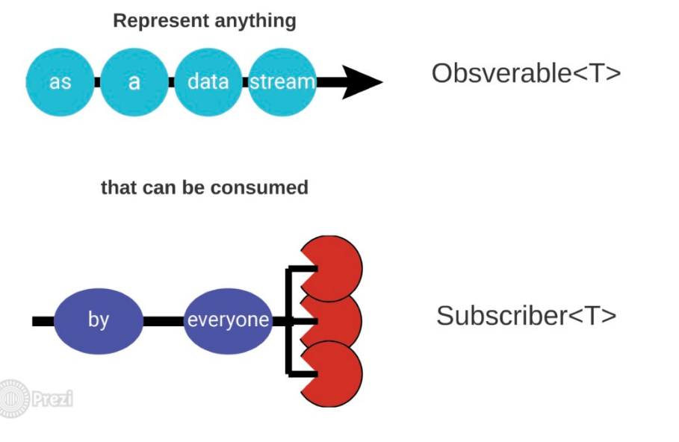
Communicate with a server- Asynchronous (4)
Observables - Asynchronous Data Streams
What is Observable?

Slide 161
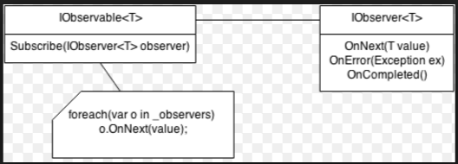
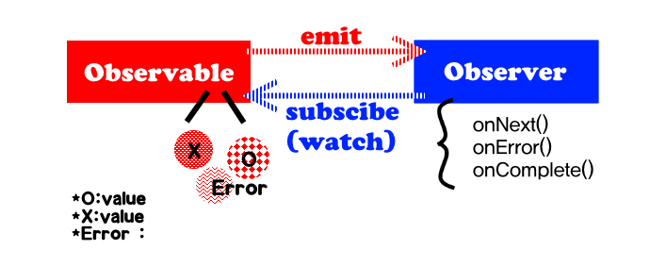
Communicate with a server- Asynchronous (5)
Observables - Asynchronous Data Streams
What is Observable?

Slide 162
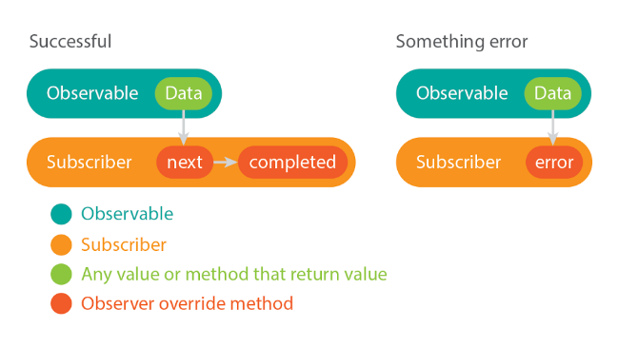
Communicate with a server- Asynchronous (6)
Observables - Asynchronous Data Streams
What is Observable?

Slide 163

Communicate with a server- Asynchronous (7)
Observables - Asynchronous Data Streams
What is Observable?

Slide 164
Communicate with a server- Asynchronous (8)
Observables - RxJS
We don’t need to implement the Observable class manually to create an observable sequence as above. Similarly, you do not need to implement Observer either to subscribe to a sequence.
By installing the Reactive Extension libraries, you can take advantage of the Observable type which provides many operators for you to create a simple sequence with zero, one or more elements. In addition, RxJS provides an overloaded subscribe method which allows you to pass in onNext, onError and onCompleted function handlers.
import {Observable} from 'rxjs/Observable'

Slide 165

Communicate with a server- Asynchronous (9)
Observable HTTP Events
Angular Http client communicates with a server using a familiar HTTP request/response protocol and return Observable which will emit a single Response when a response is received

Slide 166
Communicate with a server- Asynchronous (10)
Observable HTTP Events
The Angular 2 http module lives in a separate JavaScript file from Angular 2 core and it relies on the RxJS library. Http module @angular/http exposes a http service that our application can use to access web services over HTTP.
https://plnkr.co/edit/lyqWgQb1tDVuIrM95d6l?p=preview

Slide 167
Communicate with a server- Asynchronous (11)
Executing multiple concurrent HTTP requests
Many times, we need to load data from more than one source, and we need to delay the post-loading logic until all the data has loaded. ReactiveX Observables provide a method called forkJoin() to wrap multiple Observables. Its subscribe() method sets the handlers on the entire set of Observables.
https://plnkr.co/edit/b5PdXVyggY7ABBKonyXW?p=preview

Slide 168
Communicate with a server- Asynchronous (10)
Observable HTTP Events
The Angular 2 http module lives in a separate JavaScript file from Angular 2 core and it relies on the RxJS library. Http module @angular/http exposes a http service that our application can use to access web services over HTTP.
Before we can use the Http client , we have to import it together will all types involved in doing an http request:
Observable: http://plnkr.co/edit/0p2XwObBhQtUTM5qTzeC?p=preview
Promise: http://plnkr.co/edit/5t5rzoicG33g9MUqLFqS?p=preview

Slide 169
Communicate with a server- Asynchronous (5)
Observables - Asynchronous Data Streams
Observables is lazy, it’s just executed once we subscribe data
http://plnkr.co/edit/qiV83XQJgAvvdGrHZvyJ?p=preview
In some scenarios we may want to unsubscribe from an Observable stream. Doing this is pretty straightforward as the .subscribe() call returns a data type that we can call .unsubscribe on
http://plnkr.co/edit/H3ztyulfHAHy8HrC7uSQ?p=preview

Slide 170
Communicate with a server- Asynchronous (6)
Observables - Asynchronous Data Streams
Observables can be classified into two main groups: hot and cold Observables
Cold : Cold observables start running upon subscription, i.e., the observable sequence only starts pushing values to the observers when Subscribe is called. Values are also not shared among subscribers. Subscriber B subscribes after subscriber A. Yet subscriber B is starting to get values like subscriber A only time shifted.
http://plnkr.co/edit/qDFbZxRXOH03sQZReuXJ?p=preview
Hot: Hot observables , Values shared among subscribers
http://plnkr.co/edit/9IAmSOXmkZgJqdaSZz3C?p=preview

Slide 171
Communicate with a server- Asynchronous (7)
Observables - Asynchronous Data Streams
We can use forEach or subscribe to listen for incoming data. The key difference between forEach and subscribe is forEach returns a Promise , subscribe returns Subscription. We can think of Observable.of(1, 2, 3).forEach(doSomething) as being semantically equivalent to:
http://plnkr.co/edit/N009HzBDHvA1oZqzpOKI?p=preview
new Promise((resolve, reject) =>
{ Observable.of(1, 2, 3).subscribe( doSomething, reject, resolve); });

Slide 172
Manage State (1)
What is state in an application?
State is data that can change
Data from API are planning to display on the screen
Data in browser environment (like url)
Data on it’s way back to a backend system
Nearly anything else that can change
Source of change
User action
Backend system
Environment

Slide 173
Manage State (2)
What is state in an application?
When we mention the application state, we need to make a distinction between several types of state:
Internal Component State: each component of the component tree (like for example a dropdown) is bound to have some internal state, for example a open flag to indicate that the dropdown is opened
Global UI State: This state defines the way the user configured the UI: which language is active, which charts are visible, etc.
Application Data State: This state is the data of the application, for example a list of countries passed to a dropdown

Slide 174
Manage State (3)
What is state in an application?
State per component
Each component has a state. For example, a component which displays a list of contacts retrieved from the server might simply:
store that list of contacts in a field
loop over the contacts with NgFor for display
retrieve the contacts from an API using HTTP and subscribe.
State in interacting components
There’re some interaction between components. Then use events and bindings to push that state up and down and across the component hierarchy to other components which need to receive it.

Slide 175
Manage State (4)
What is state in an application?
3. State in one component (app component) at the top
Bind data downward, emit change in events upward. To implement that, move state ownership upward through the component hierarchy, such that each piece of state is owned at a high enough level that it can be pushed down to any other components that need it. In extreme cases, some applications have essentially all of their state all the way in a top-level component
4. State in services
5. State in Observables (in services)

Slide 176

Manage State (5)
When should we manage state?
We just need to manage state with medium or large apps that have complex data flows.
If we re building a simple app with simple data flow to three component and services then we don’t need necessarily to manage state because Redux or ng2-redux (we will talk about this later) can add extra necessary complexity to our app. This is an example of simple app

Slide 177


Manage State (6)
What are large apps?
If we start developing app, it gets a little bit more tangles
Lots of parts
Everything is connected to everything
Change something breaks something somewhere

Slide 178


Manage State (7)
Why need to manage state?
If we have a component that’s talking to a model, when model changed, the view of model will be changed and when view changed, model will be changed as well. With small-scale application works fairly well
However the problem will happens when we multiple components need information from one model or others models. We will have a spider web. It gets to be really hard to understand what’s happing in the app and why

Slide 179

Manage State (8)
Why need to manage state ?
We also get another issue with multiple views that are working with the same piece of data and do not have a parent-child relationship. And this case we often have multiple copies of the same data that is independent each other. So when update the model we have to do some extra work to keep other view in sync

Slide 180

Manage State (9)
Why need to manage state ?
Let think of Facebook, on Facebook we have 3 views that present the current state of user messages. They r independent need to be in sync
On navigation bar we have an icon to show the number of messages
View on messages page
Multiple chat tabs at the bottom

Slide 181


Manage State (10)
Why need to manage state?
The most important here they don’t have a parent-child relationship
A common solution is use Mediator Design Pattern-Parent as Mediator

Slide 182
Manage State (11)
Why need to manage state ?
But this solution is not good in large application because
We have Events published all over the places and then to track what happens to application state, we have to jump all over the code to see what is going on.
We use property binding , this make components tightly couple
The problem with this approach is the data can be updated in an unpredictable way. When there ‘s a bug we have to jump all over the code to figure out how is data is flowing and how is application state updated in multiple places.
Adding new feature becomes a challenge because once again we don’t know what is the impact of this new feature on application

Slide 183
Manage State (14)
How to manage state?
There are 4 main ways to solve issues.
Use Redux directly
Use Redux using ng2-redux
Use Redux using @ngrx
Angular Services and RxJS.
Notes:
https://gist.github.com/btroncone/a6e4347326749f938510
http://onehungrymind.com/build-better-angular-2-application-redux-ngrx/
https://github.com/bodiddlie/rxheroes/blob/master/app/actions/hero.ts
http://bodiddlie.github.io/ng-2-toh-with-ngrx-suite/

Slide 184
Manage State – Redux (1)
What is redux?
Redux is a library helps us manage the state of application
Redux is a data flow pattern
We can run Redux in any application that suitable for component driven like AngularJs, Angular or React
Redux benefits ?
Decouple architecture
Testability (We don’t need more mocks or spies)
Redux makes app incredibly easy to implement feature like redo and undo

Slide 185

Manage State – Redux (2)
Redux key ideas ?
All of your application’s data is in a single data structure called the state which is held in the store
Your app reads the state from this store
This store is never mutated directly
User interaction (and other code) fires actions which describe what happened
A new state is created by combining old state and the action by a function called the reducer

Slide 186

Manage State – Redux (3)
Redux data flow?

Slide 187


Manage State – Redux (4)

Slide 188
Manage State – Redux (4)
Redux- Store?
The Store holds the whole state of the application, receives the Action and sends it to the Reducers along with the current state
The Store receives this new state and replaces the current one with it. It’s worth noting here that when we say the state is updated, it is technically replaced.
When the state changes, the Store triggers a change event.
The Store offers an API to:
Dispatch actions by appStore.dispatch(action)
Register listeners for change notification: appStore.subscribe(callback)
Read the Application State: appStore.getState()

Slide 189
Manage State – Redux (5)
Redux- Action
An action MUST
be a plain JavaScript object.
have a type property.
An action MAY
have an error property.
have a payload property.
have a meta property.
An action MUST NOT include properties other than type, payload, error, and meta.

Slide 190
Manage State – Redux (6)
Redux- Action
type
Type property that indicates the type of action being performed. Types should typically be defined as string constants. If two types are the same, they MUST be strictly equivalent (using ===).
payload
The optional payload property MAY be any type of value. Payload is an object holding all the information needed by the reducers
error
The error property is a Boolean that indicates whether the action is in an error state.
The rationale behind this is that instead of having multiple actions, like 'ADD_RECIPE_SUCCESS‘ and 'ADD_RECIPE_ERROR', we can have only one action, 'ADD_RECIPE', and use the error flag
to determine the status.
meta
The meta property holds additional metadata about the action that is not necessarily needed by the reducers, but could be consumed by middleware.

Slide 191
Manage State – Redux (7)
Redux- Action
If the action were in the error state (for example, in the event of a rejected promise or API failure), the payload would hold the error itself, be it an Error() object or any other value defining the error
String Constants
Let’s consider the problems that using strings for type can cause in a large code base:
1. Spelling mistakes—If we spell the same string incorrectly in the action or the reducer, our action will fire but result in no changes to the state. Worst of all, this will be a silent failure without any message to indicate why our action failed to produce its desired effect.
2. Duplicates—Another developer, in a different part of the code base, might use the same string
for an action. This will result in issues that are very hard to debug, as our action will suddenly cause that developer’s reducers to fire as well, creating unexpected changes to the state.
Notes:
https://github.com/acdlite/flux-standard-action

Slide 192
Manage State – Redux (8)
Redux- Action
String Constants
To avoid these issues, we need to ensure a unique naming convention for our actions to allow both action creators and reducers to use the exact same keys. All the keys used for type are stored in a single constants file and imported by both action creators and reducers. Using a single file allows us to rely on JavaScript itself to catch duplication errors. The file will have this form:
Notes:
https://github.com/acdlite/flux-standard-action

Slide 193
Manage State – Redux (9)
Redux- Action Creator
If we decide to use the same action in other places, we will end up duplicating the logic in multiple locations. Such code is hard to maintain, as we will have to synchronize all the changes between all the occurrences of the action.
A better approach is to keep the code in one place. We can create a function that will create the action object for us:
Any modification to the content or logic of the action can now be handled in one place: the action creation function, also known as the action creator

Slide 194
Manage State – Redux (10)
Redux- Reducer
A Reducer is a pure function that takes the current state and an Action, then returns a new state based on any changes that the Action might have indicated.
Reducers in Redux are pure functions, meaning they don’t have any side effects such as changing
local storage, contacting the server, or saving any data in variables

Slide 195
Manage State – Redux (11)
Redux- Reducer
A Reducer is a pure function that takes the current state and an Action, then returns a new state based on any changes that the Action might have indicated.
Reducers in Redux are pure functions, meaning they don’t have any side effects such as changing
local storage, contacting the server, or saving any data in variables
Notes:
https://plnkr.co/edit/lbmWtbu4iwoLyI1tiFCk?p=preview

Slide 196
Unit Testing
TestBed
TestBed is the primary api for writing unit tests for Angular applications and libraries.
Configures and initializes environment for unit testing and provides methods for
* creating components and services in unit tests.

Slide 197
Unit Testing
TestBed - Configure Testing Module

Slide 198
Unit Testing
ComponentFixture - Fixture for debugging and testing a component.
Create fixture = TestBed.createComponent(BannerComponent);
Create instance feature: comp = fixture.componentInstance

Slide 199
Webpack (1)
What is Webpack?
The dynamic web applications usually have lots of JavaScript files. These files are either created by you or it could be third party libraries like jquery/bootstrap etc. We include these in our index.html file using <script> tag.
When a user sends requests to our application, the browser requests and loads these files one at a time. If you have lots of these files, then it will make your application slow.
The solution to this problem is to merge all these files into a one or two files so that the browser can download the entire file in one request. This is where Webpack is used.
Webpack is a bundler, which scans your web application looking for javascript files and merges them into one ( or more) big file. Webpack has the ability to bundle any kind of file like JavaScript, CSS, SASS, LESS, images, HTML, & fonts etc.
Notes:
https://medium.com/@rajaraodv/webpack-the-confusing-parts-58712f8fcad9
https://damienbod.com/2016/06/12/asp-net-core-angular2-with-webpack-and-visual-studio/

Slide 200
Webpack (2)
Webpack’s Core Philosophy ?
Two core philosophies of Webpack are:
Everything is a module — Just like JS files can be “modules”, everything else (CSS, Images, HTML) can also be modules. That is, you can require(“myJSfile.js”) or require(“myCSSfile.css”). This mean we can split any artifact into smaller manageable pieces, reuse them and so on.
Load only “what” you need and “when” you need — Typically module bundlers take all the modules and generate a large single output “bundle.js” file. But in many real-world apps, this “bundle.js” could be 10MB-15MB and could take forever to load! So Webpack has various features to split your code and generate multiple “bundle” files, and also load parts of the app asynchronously so that you just load what you need and when you need it.

Slide 201

Webpack (3)
Development Vs Production?
First thing to be aware of is that Webpack has tons of features. Some are for “Development-only”, some others are for “Production-only” and some are for both “Production-and-Development”.

Slide 202

Webpack (4)
webpack CLI Vs webpack-dev-server?
It’s important to note that Webpack, the module bundler, provides two interfaces:
Webpack CLI tool — the default interface (installed as part of Webpack itself)
webpack-dev-server tool — A Node.js server (You need to install it separately)

Slide 203
Webpack (5)
webpack CLI (Good for Production Builds)?
This tool takes options via CLI and also via a config file (default: webpack.config.js) and gives it to the Webpack for bundling
Add it to package.json's script “scripts”: { “build”: “webpack --config webpack.config.prod.js -p”, ... }
//Use it by running the following: "npm run build"

Slide 204
Webpack (6)
webpack-dev-server (Good for Development Builds)
This is an Express node.js server that runs at port 8080 (we can change port). This server internally calls Webpack. The benefit of this is that it provides additional capabilities like reloading the browser i.e. “Live Reloading” and/or replacing just the changed module i.e “Hot Module Replacement” (HMR).
“scripts”: { “start”: “webpack-dev-server --inline --progress --port 65337”, ... }// Use it by running $ npm start
//Open browser at: http://localhost: 65337
Notes:
https://webpack.js.org/configuration/

Slide 205
Webpack (7)
Webpack-dev-server CLI options Vs config options
The other thing to note is you can pass options to webpack-dev-server in two ways:
Through webpack.config.js’s , “devServer” object.
devServer: { inline: true, progress: true }
Through CLI options.
webpack-dev-server -- progress --inline//Via webpack.config.js

Slide 206

Webpack (8)
“entry” — String Vs Array Vs Object
Entry tells the Webpack where the root module or the starting point is. This can be a String, an Array or an Object. This could confuse you but the different types are used for different purposes.
If you have a single starting point (like most apps), you can use any format and the result will be the same.

Slide 207

Webpack (9)
entry — Array
But, if you want to append multiple files that are NOT dependent on each other, you can use the Array format.
For example: you may need “googleAnalytics.js” in your HTML. You can tell Webpack to append it to the end of the bundle.js like so:

Slide 208

Webpack (10)
entry — object
Now, let’s say you have true multi-page application, not a SPA w/ multi-views, but with multiple HTML files (index.html and profile.html). You can then tell Webpack to generate multiple bundles at once by using entry object.
The below config will generate two JS files: indexEntry.js and profileEntry.js that you can use in index.html and profile.html respectively.
//profile.html <script src=”dist/profileEntry.js”></script>
//index.html <script src=”dist/indexEntry.js”></script>

Slide 209

Webpack (11)
entry — combination
You can also use the Array type entries inside an entry object. For example the below config will generate 3 files: vendor.js that contains three vendor files, an index.js and a profile.js.

Slide 210

Webpack (12)
output — “path” Vs “publicPath”
output tells the Webpack where and how to store the resulting files. It has two properties “path” and “publicPath” that could be confusing.
“path” simply tells the Webpack where it should store the result. Where as “publicPath” is used by several Webpack’s plugins to update the URLs inside CSS, HTML files when generating production builds.

Slide 211
Webpack (13)
Loaders
Loaders are additional node modules that help ‘load’ or ‘import’ files of various types into browser acceptable formats like JS, Stylesheets and so on. Further loaders also allow importing such files into JS via “require” or “import” in ES6.

Slide 212

Webpack (14)
Loaders

Slide 213
Webpack (15)
Loaders
Webpack searches for CSS files dependencies inside the modules. That is Webpack checks to see if a JS file has “require(myCssFile.css)”. If it finds the dependency, then the Webpack gives that file first to the “css-loader”
css-loader loads all the CSS and CSS’ own dependencies (i.e @import otherCSS) into JSON. Webpack then passes the result to “style-loader”.
style-loader to take the JSON and add it to a style tag — <style>CSS contents</style> and inserts the tag into the index.html file.

Slide 214

Webpack (16)
Loaders Themselves Can Be Configured
Loaders themselves can be configured to work differently by passing parameters.
In the example below, we are configuring url-loader to use DataURLs for images less than 1024 bytes and use URL for images that are larger than 1024 bytes. We can do this by passing “limit” parameter in the following two ways:

Slide 215
Webpack (17)
Plugins
Plugins are additional node modules that usually work on the resulting bundle.
For example, uglifyJSPlugin takes the bundle.js and minimizes and obfuscates the contents to decrease the file size.
Similarly extract-text-webpack-plugin internally uses css-loader and style-loader to gather all the CSS into one place and finally extracts the result into a separate external styles.css file and includes the link to style.css into index.html
HtmlWebpackPlugin :Simplifies creation of HTML files (index.html) to serve your bundles
CommonsChunkPlugin : Generates chunks of common modules shared between entry points and splits them into separate bundles, e.g., vendor.bundle.js && app.bundle.js
ContextReplacementPlugin : Context refers to a require with an expression such as require('./locale/' + name + '.json'). When encountering such an expression, webpack infers the directory ('./locale/') and a regular expression (/^.*\.json$/). Since the name is not known at compile time, webpack includes every file as module in the bundle.
The ContextReplacementPlugin allows you to override the inferred information. There are various ways to configure the plugin:
Notes:
https://webpack.js.org/plugins/

Slide 216
Webpack (18)
Resolving File Extensions
Many Webpack config files have a resolve extensions property that has an empty string like shown below. The empty string is there to help resolve imports without extensions like: require(“./myJSFile”) or import myJSFile from ‘./myJSFile’ without file extensions.
{ resolve: { extensions: [‘’, ‘.js’, ‘.jsx’] } }
Notes:
https://webpack.js.org/plugins/

Slide 217
Workshop
Refer to Angular2_Workshop_StepByStep file

Slide 218

THANK YOU
Notes:
http://valor-software.com/ngx-bootstrap
https://valor-software.com/ng2-handsontable/
https://help.syncfusion.com/angular-2/grid/getting-started
http://valor-software.com/ng2-table/
https://valor-software.com/ng2-dragula/

